Slide 1
Instrumentation for gravitational-wave detection
Conor Mow-Lowry
BND School Wuppertal 2023

Slide 2
Overall plan
We have 4 sessions of 1.5 hours. We’ll tackle 3 major topics:
What is the sensitivity plot, and what does it mean?
How does the gravitational wave turn into a signal we can measure, and how does laser frequency noise affect it?
How on Earth can you measure 10⁻¹⁹m when the ground shakes all the time by 10⁻⁶m?!
And a “fun” look at LIGO with some Q&A

Slide 3
Session 1
Gravitational waves and the first detection
A look at LIGO and a brief history in photos
What have we seen since then?
What is the future of gravitational-waves, and the importance of low-frequencies
Slido Q&A – idle curiosity, burning questions, things you always wanted to ask but were too afraid

Slide 4
Slido for questions
Add your questions or upvote those already posted and I’ll try to answer them.
Fully anonymous!
Slido #921 8346
https://app.sli.do/event/feM5JT34qMLuDUDwBXHDDH

Slide 5
Session 2
Thinking in the frequency domain
Fourier Transform and its properties
Autocorrelation and spectral densities
‘Building’ a spectrum analyser
Deconstructing the sensitivity curve.
The physical interpretation of the curve
The dominant ‘fundamental’ noises
How to build a noise budget
A brief look at a ‘real’ noise budget

Slide 6
Session 3
Laser interferometry: Phase to power
Maxwell’s equations to the wave equation
Plane waves and simplifications
Measuring a laser beam and our simplest nomenclature
Tutorial 1:
Calculate the response to a gravitational wave
Project laser frequency fluctuations into ‘strain equivalent’ noise.

Slide 7
Session 4
Seismic noise
Physical origins
Passive and active isolation
The reality in detectors
Tutorial 2: Mechanics in the frequency domain.
Calculate the response of a seismometer
Build a noise budget with readout noise and thermal noise.

Slide 8
Ripples in spacetime

Slide 9
GW150914: Blackholes with 36M_{s} and 29M_{s} combine to make a bigger Blackhole with 62M_{s} Remaining 3M_{s} ejected as energy.
Credit: LIGO/T. Pyle

Slide 10
WHAT ARE GRAVITATIONAL WAVES? THEIR EFFECT ON SPACETIME
Credit: LIGO/R. Hurt
The Earth only stretches by the diameter of a proton
Notes:
PUT your arms up!!
Travels 1 million light years.
What does grwvitational energy do when it gets to earth.
Looks dramatic but:
4 km LIGO arm by a thousandth of the width of a proton
~changing the distance to the nearest star outside the Solar System (Alpha Centauri) by one hair's width
Incredible. How on earth do we do that?

Slide 11
FIRST DECTECTION – GW150914
29
36
3 suns gravitational wave energy
62
Notes:
1st detection!
Data 0.007s to travel between detectors.
Exactly agreed with general relativy!
1 million light years away

Slide 12
Now in more sensible units…
E = mc²
E_{gw} = 3*M_{sun}*c²
M_{sun} = 2*10³⁰kg;
c = 3*10⁸m/s
E_{gw} = 5.4 * 10⁴⁷ J
E_{butter} = 717 (* 100g) cal
E_{butter}/kg = 10*E_{butter}*10³*4.2
= 3 * 10⁷ J
M_{butter} = E_{gw}/(E_{butter}/kg)
= 1.8 * 10⁴⁰ kg
Finally giving
E_{gw} => 9 GM_{sun}
worth of butter
(Also interesting… P_{universe} ~ 10⁴⁸ W)

Slide 14
http://data.cardiffgravity.org/waveform-fitter/
Notes:
Our first detectoin of gravitational waves was in 2015. We have since added on 89 detections to a total of 90! I’m going to show you what the first one looks like And sounds like. We don’t really hear gravitational waves but the frequency of the stretches and squishes of spacetime is a good frequency to hear it,
This is the wave of two blackholes 36 and 29 M (3 radiated) 1.4billion Light years away.
Story of how this was the day BEFORE observing started.

Slide 15
What have we seen since then?

Slide 16
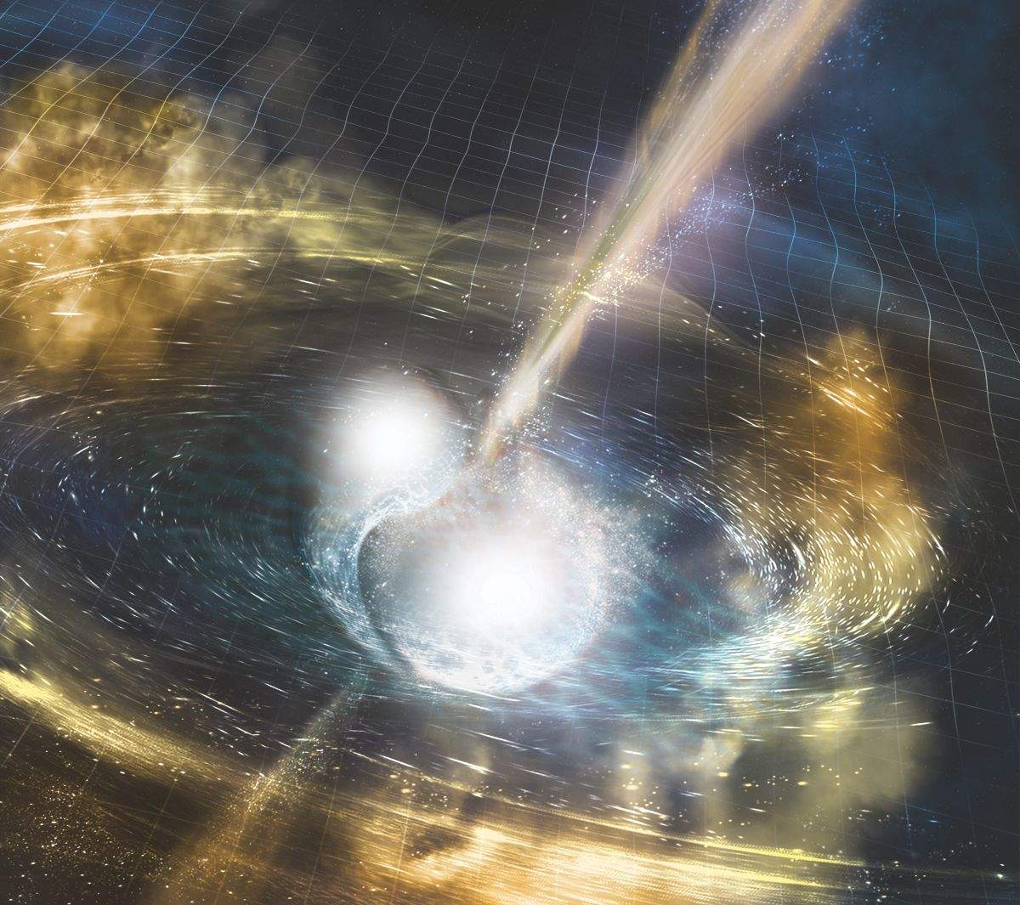
The ‘golden binary’
7 more BBH signals and the ‘golden binary’
~4000 authors (1/3 of the global astronomy community)
84 papers on day 1, and 700k results if you google ‘170817’

Slide 17
FIRST DECTECTION OF NEUTRON STAR MERGER – GW170817
Credit: NASA GSFC & Caltech/MIT/LIGO Lab
Notes:
Data analysis is being done of GW data from LIGO and VIRGO. Comparing the signals. Looking for anything interesting, comparing to models. This is all done automatically too. Wakes up one senior scientist from each site.
130 million light years
Neutron starts on the other hard are bright. They emit light. And now (as of 2017) we know that when NS collide they emit wavelengths of light from all over the electromagnetic spectum!
This is what the spacetime deformation from the two NSs collsioin sounds like:
Show video

Slide 18
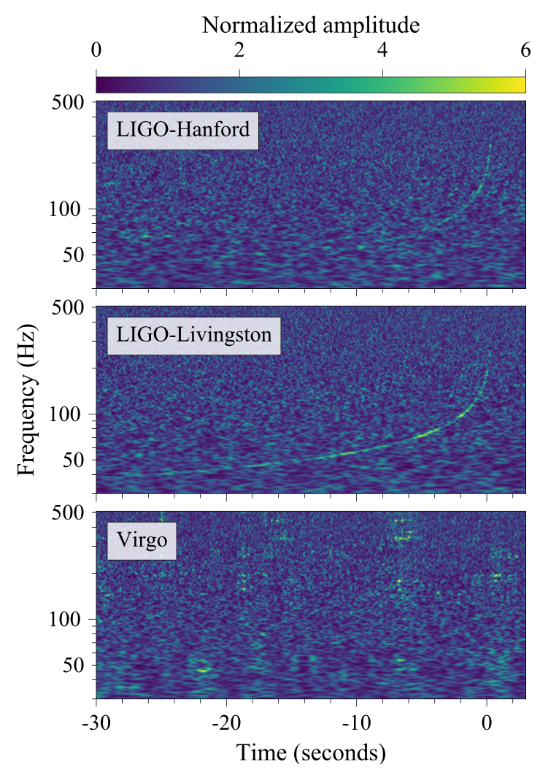
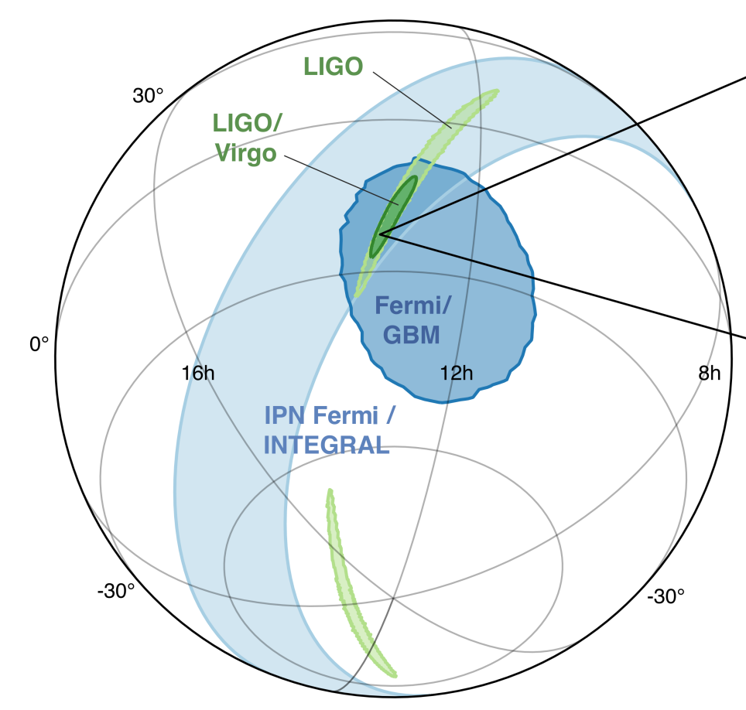
Notes:
Now I want you to focus on green. Light green – LIGO Hanford + liv, so top two plots on left. Dark green is with added information that it wa in vorgos blind spot!
Blue areas are localistion form the Gamma ray burst. They overlap!!!! This is great! Now, can we see it?

Slide 19
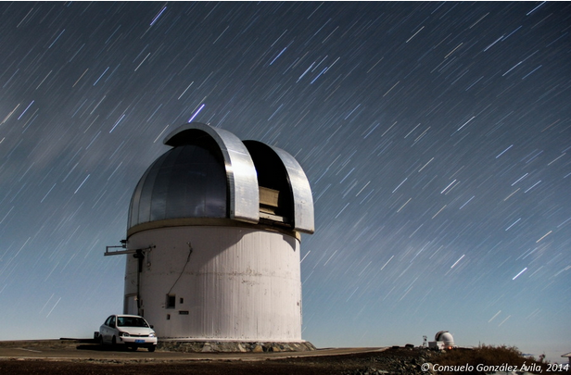
+10 hours 52 minutes
Notes:
By this time it’s now ~5am in the US, in August. The constellation Hydra is in the Sothern hemisphere.
So its too light in S. America and Africa. The constellation has already set in the sky in Australria. So now we wait. All the obseritoies around the workd are waitng for the sun to set again in Chille.

Slide 20
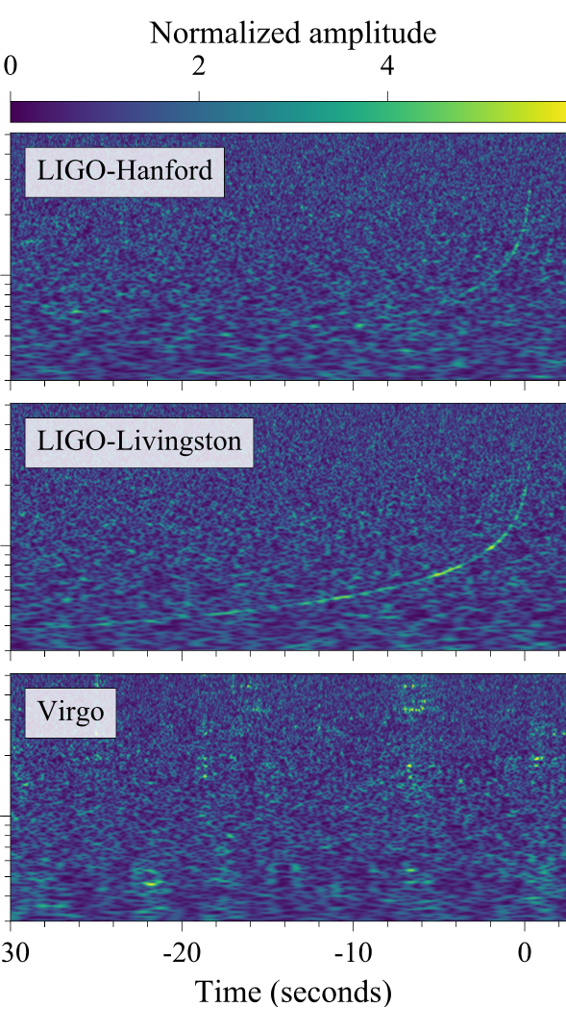
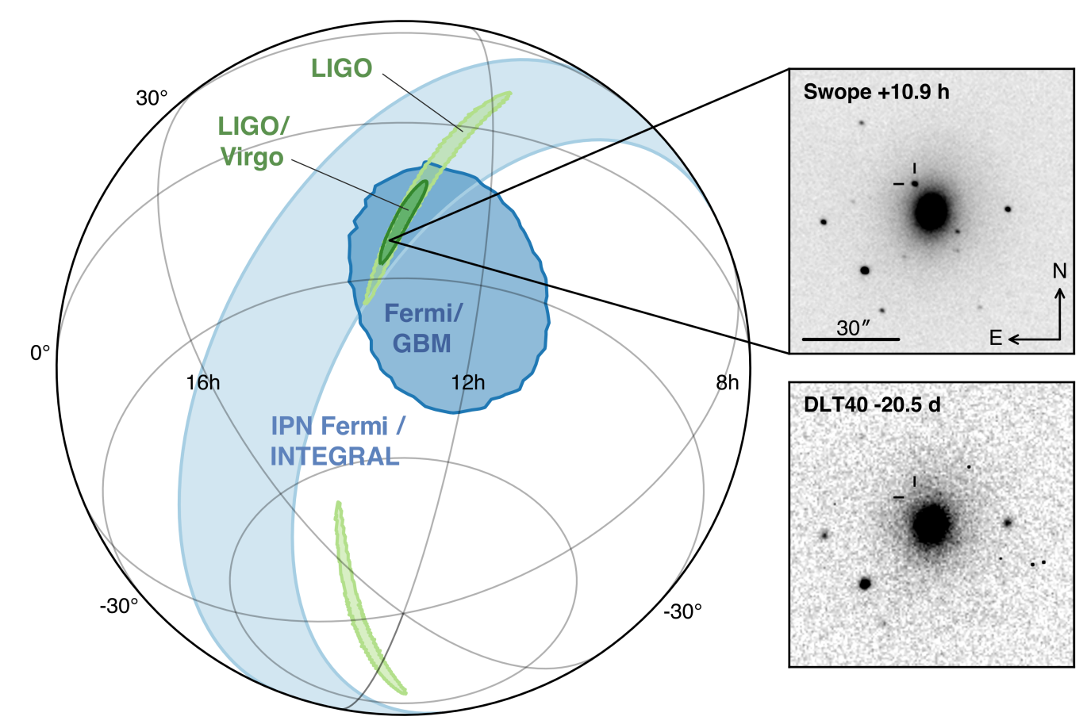
https://www.ligo.org/
Notes:
Before and anfter see bright source (vsiable light)
Kila nova
decaying neurton rich material – produces heavy element
Gamme + GW = speed of light vs speed GWs
A different way of Hubble constant

Slide 21
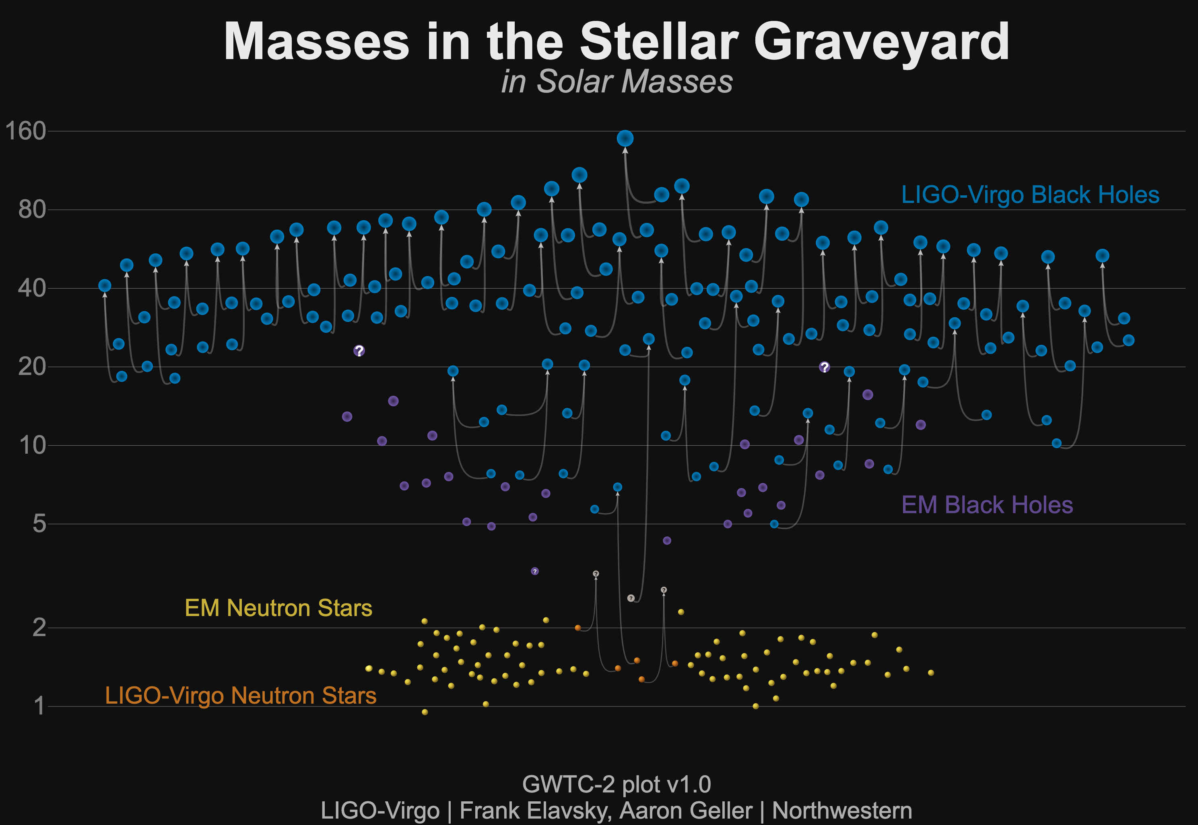
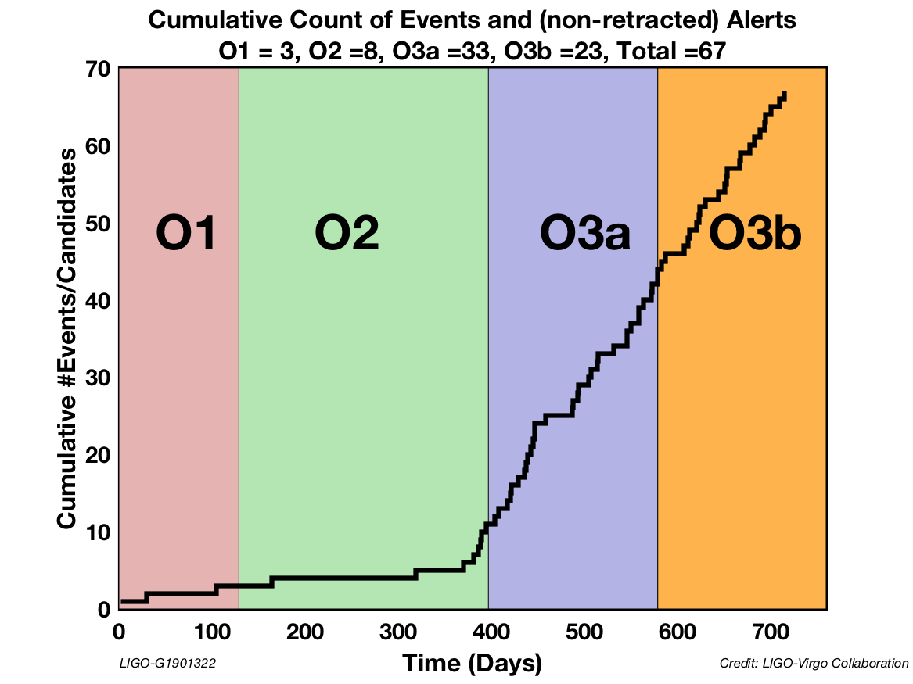
Frequent observation of binary coalescences
About one signal
detected per week!

Slide 22
A look at LIGO

Slide 23
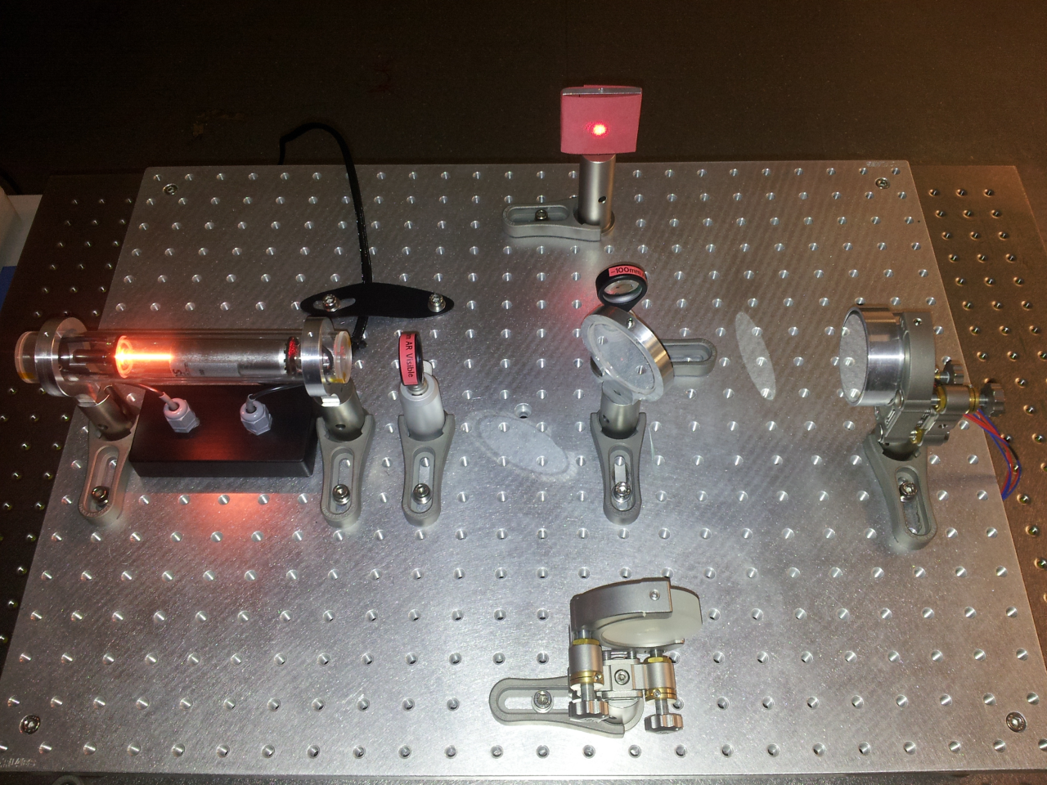
Michelson interferometer
Output
Test
Mass
Laser
Beamsplitter
Test
Mass

Slide 24
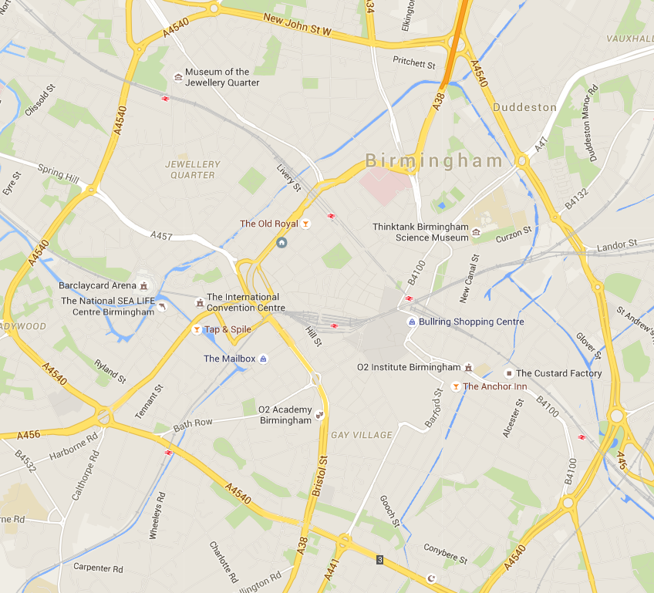
Images: LIGO Laboratory and Google Maps

Slide 25
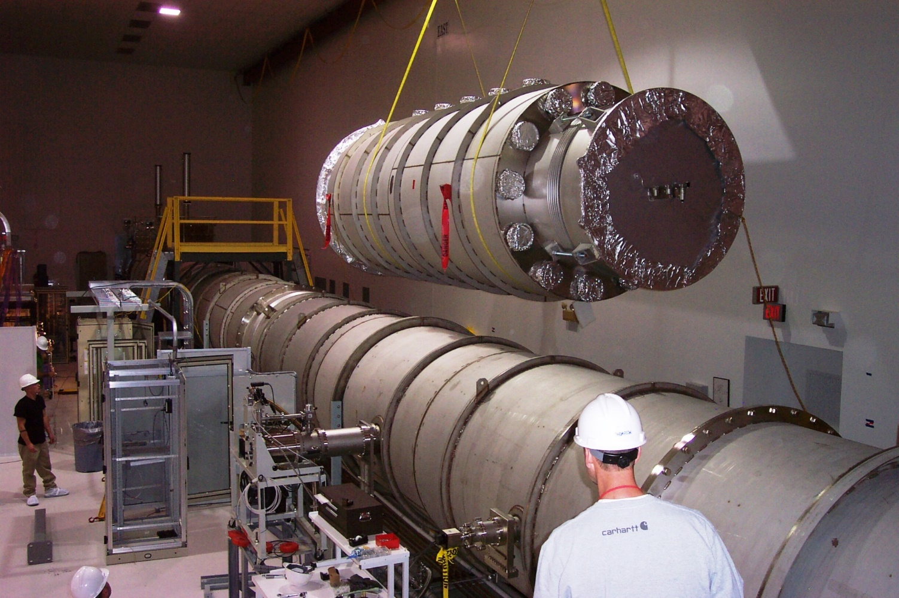
Images: LIGO Laboratory

Slide 26
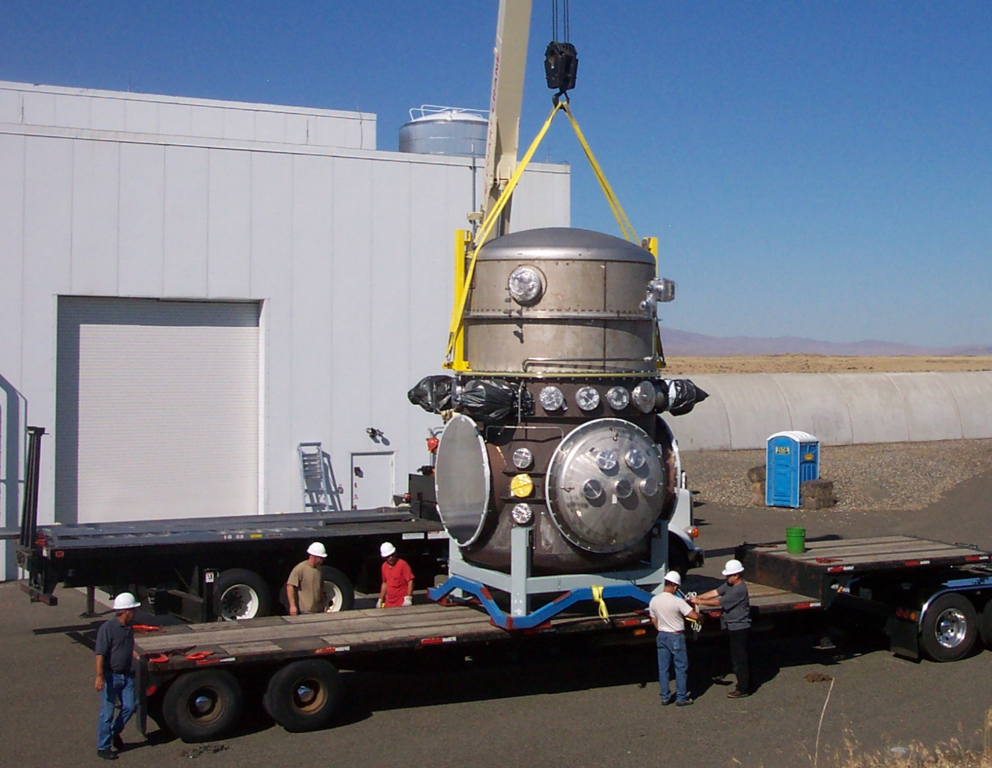
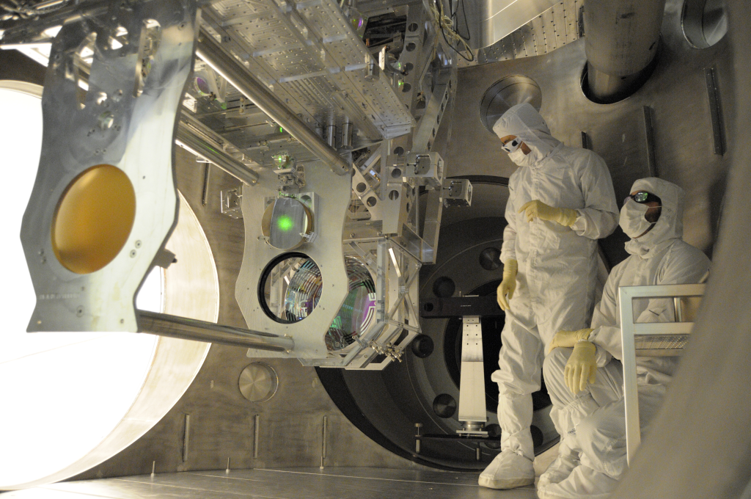
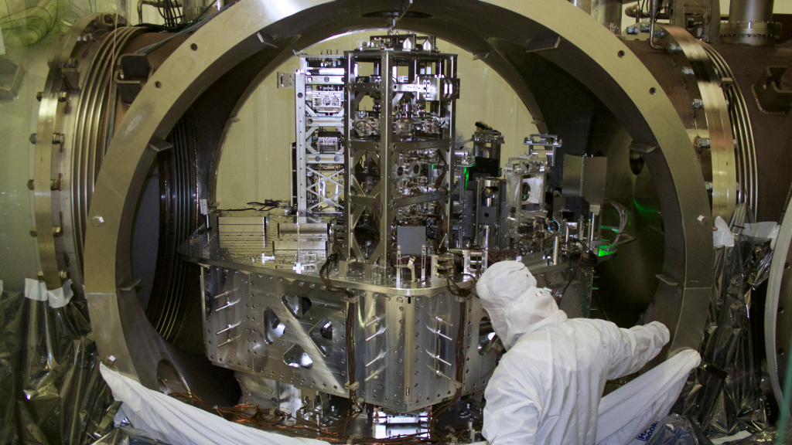
Images: LIGO Laboratory

Slide 27
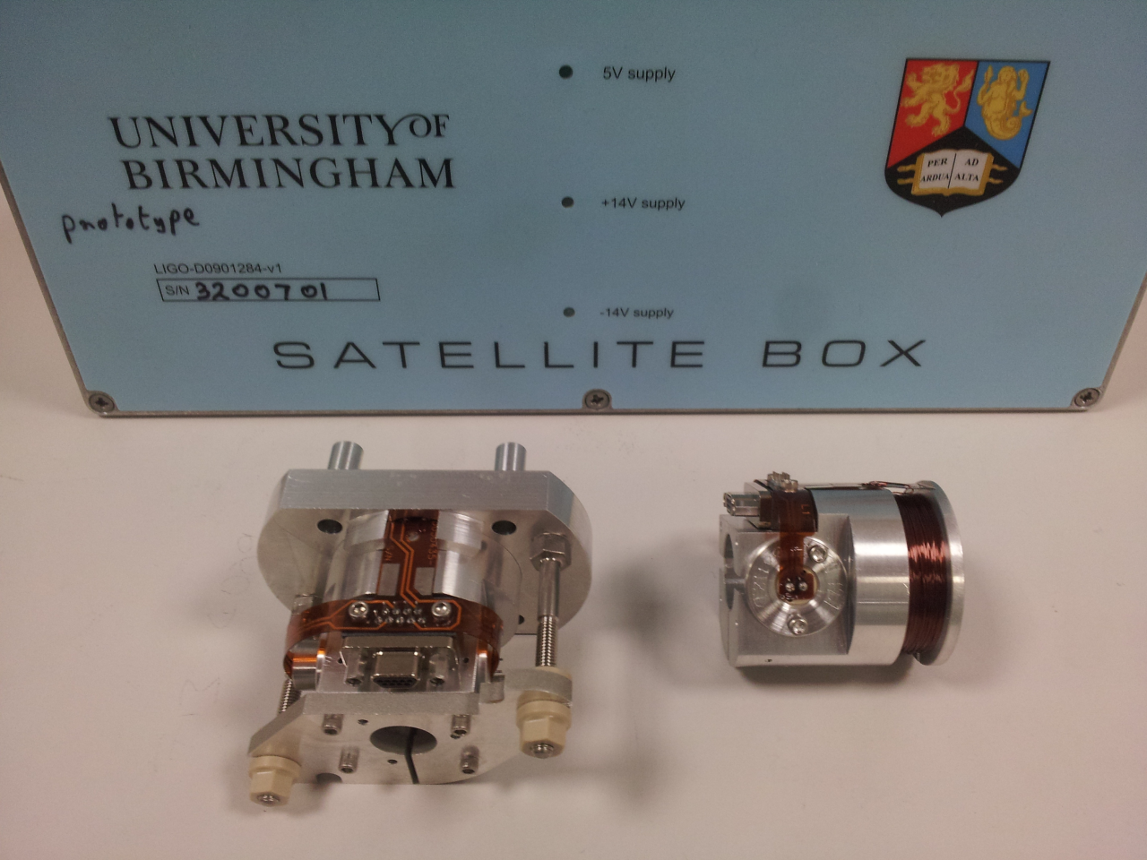
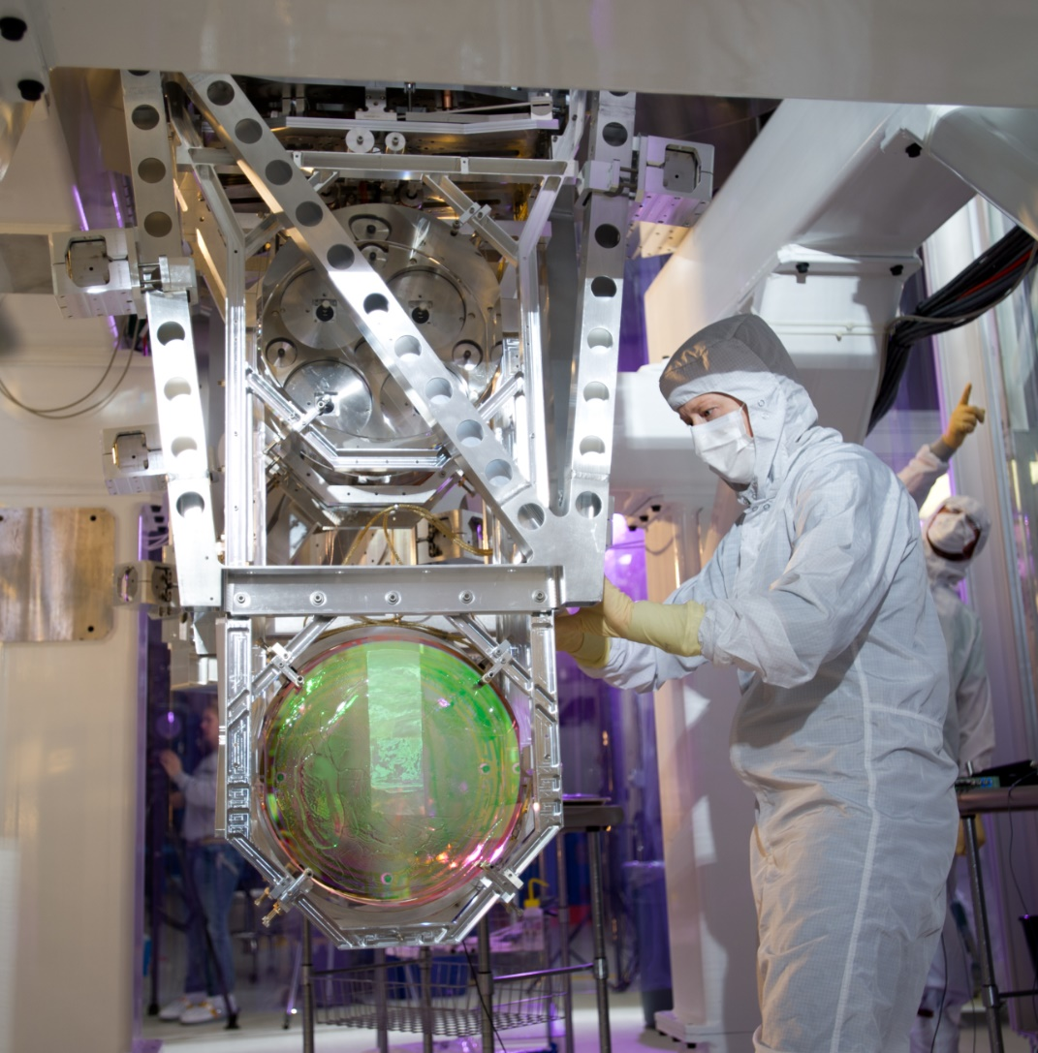
Images: LIGO Laboratory

Slide 28
A brief history in pictures

Slide 29
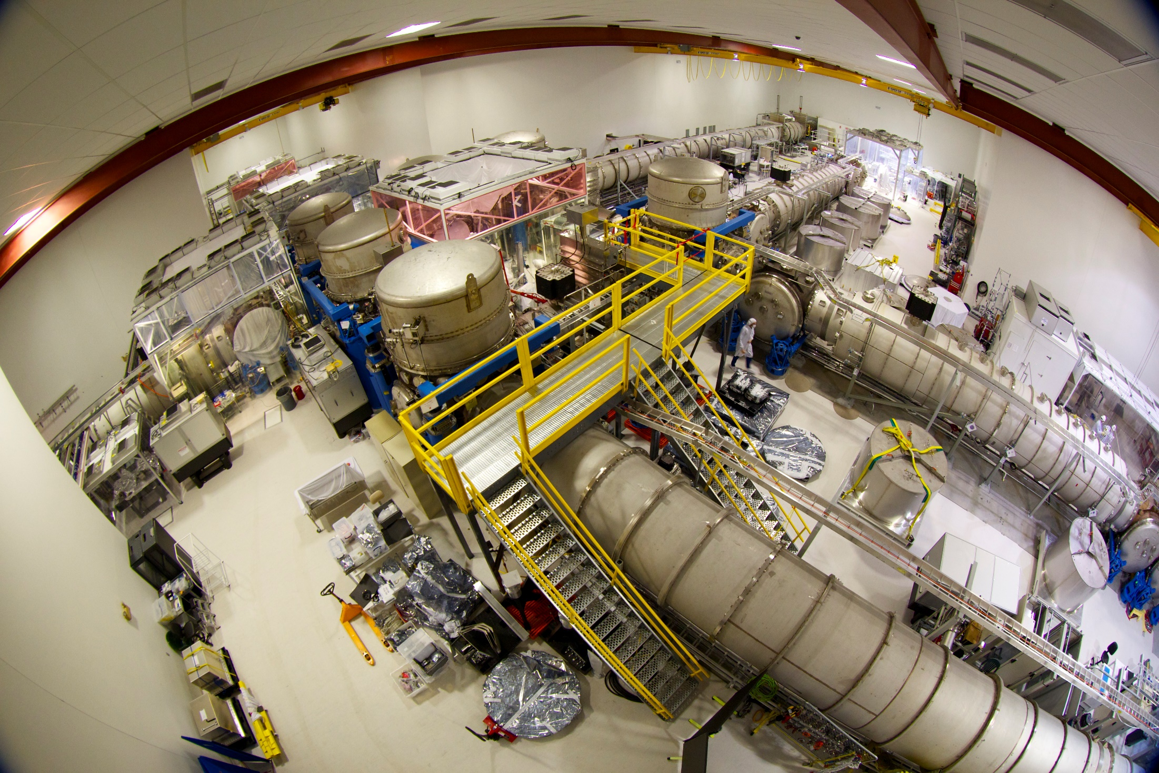
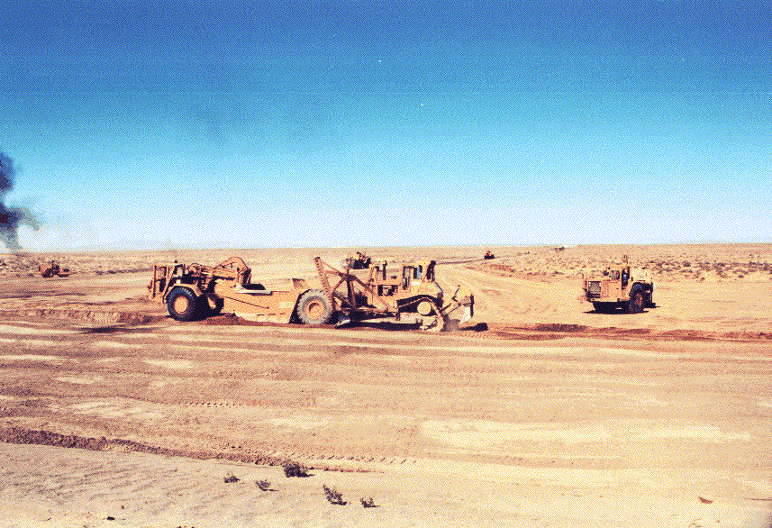
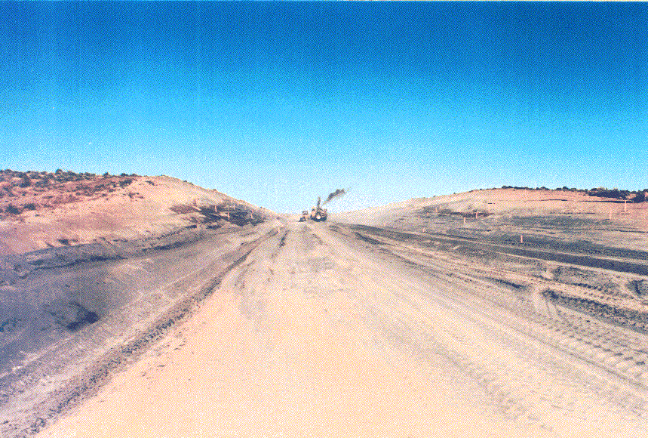
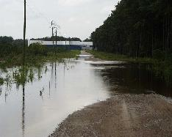
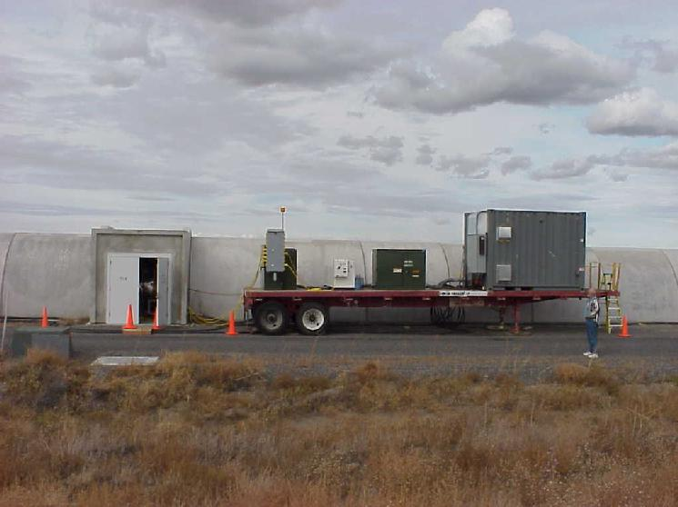
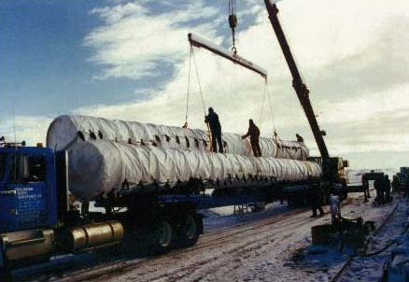
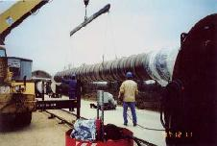
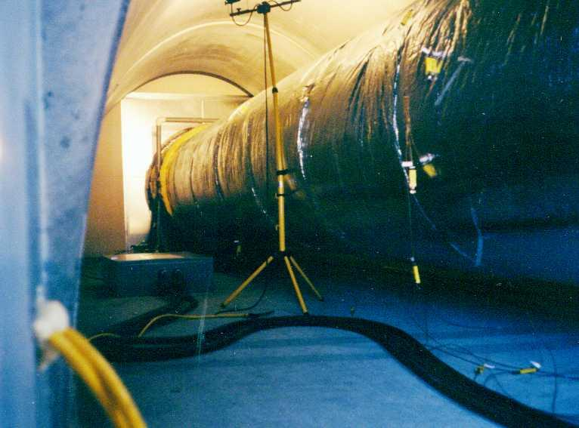
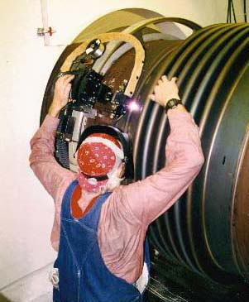
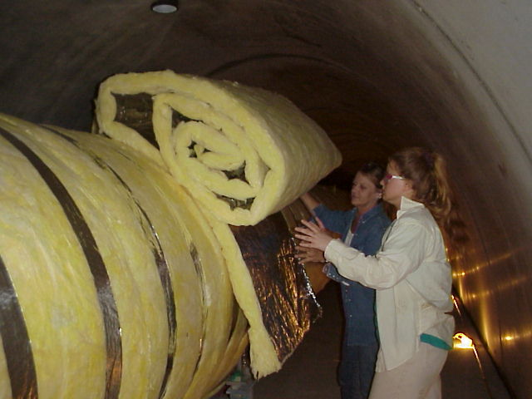
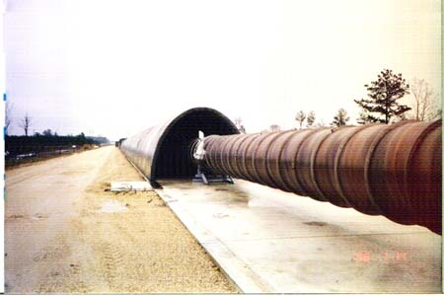
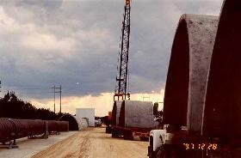
beamtube
transport
Concrete
Arches
beamtube
install
girth
welding

Slide 30
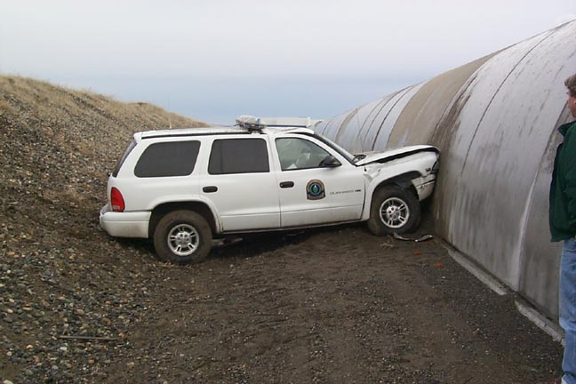
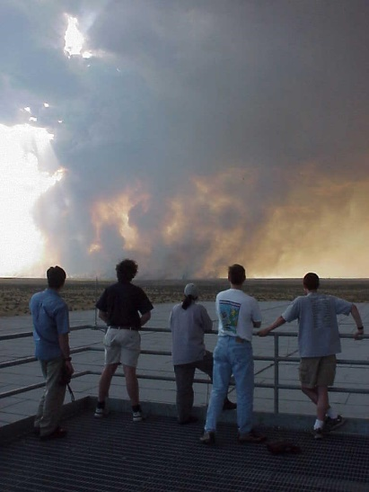
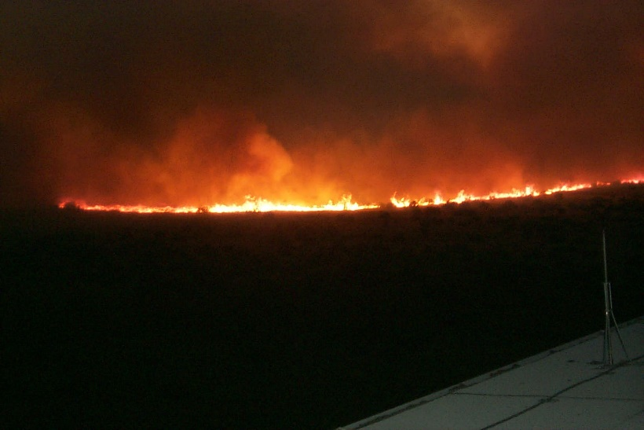
Other uses for LIGO
LIGO as a car stop
a view from the bridge
desert on fire
LIGO as a fire break

Slide 31
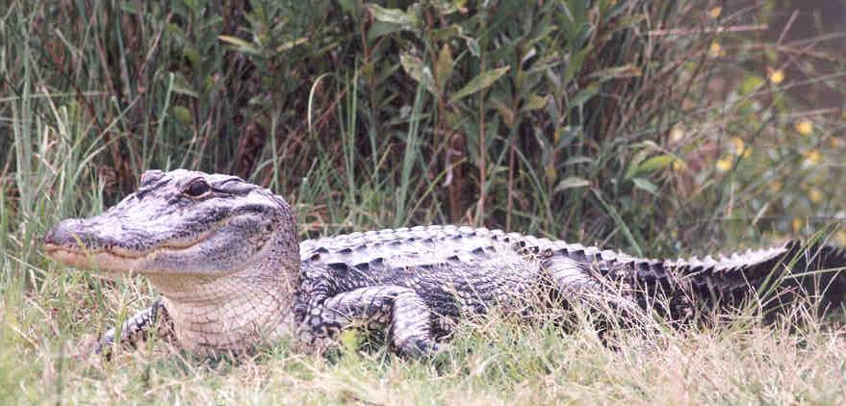
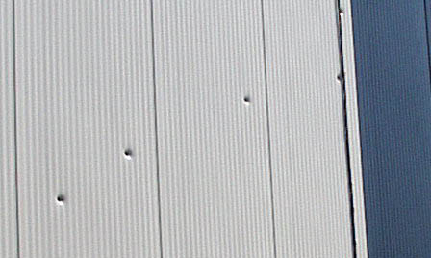
Other uses for LIGO
collecting bullet holes
pet alligator

Slide 32
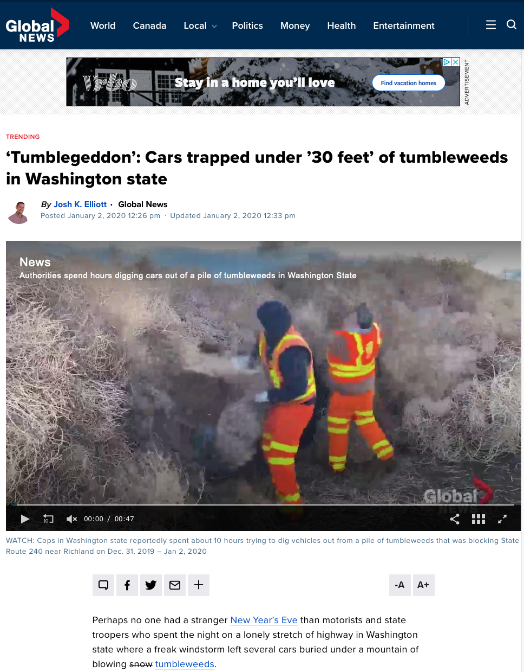
Notes:
Tumbleweeds

Slide 33
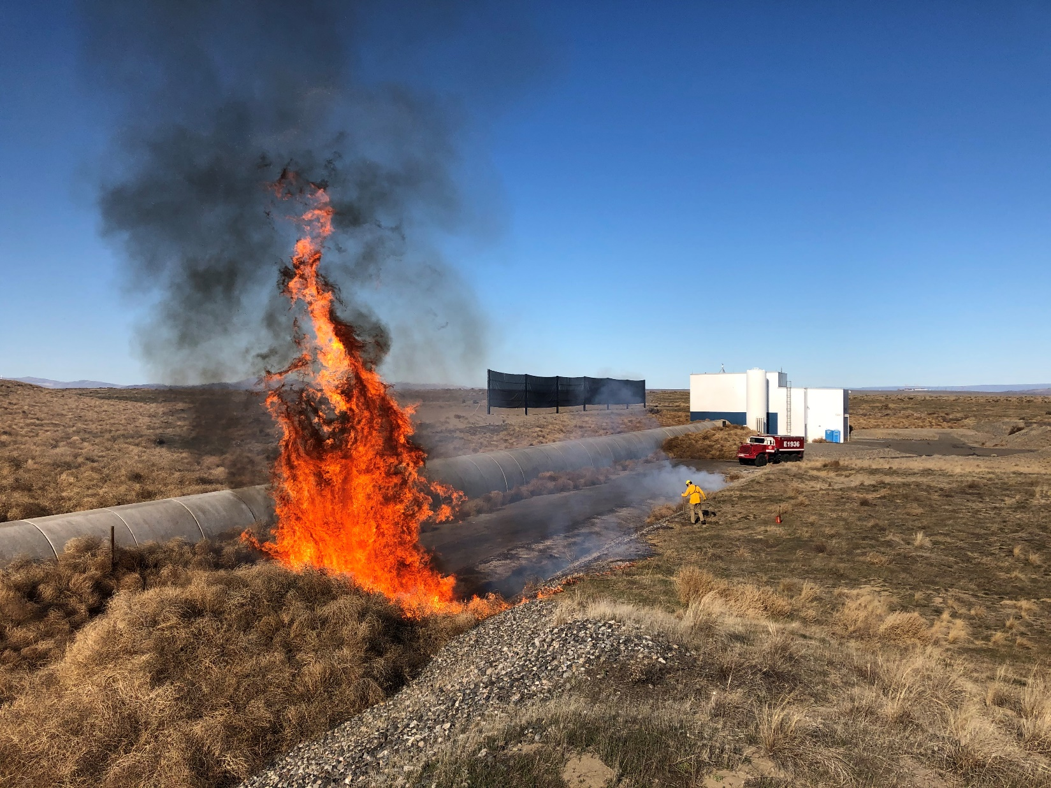

Slide 34
Looking to the future – the Einstein Telescope

Slide 35
The Einstein Telescope
A multi-billion Euro, pan-European project involving thousands of people.
There is a possibility of it “landing” in NL, and we are a major part of the ET project and collaboration leadership
We must make strategic decisions – the project is too big to ‘fit’ in Nikhef as it stands.
Groeifonds – No direct funding for scientists
Currently ongoing: Site-studies, collaboration building, prototyping, research projects

Slide 36
The Einstein Telescope, the EU project timeline
2021
ET is added to the ESFRI roadmap
2024
The 2 sites in competition, EMR and Sardinia, have to deliver their bid
2026
preparation & realization/ building ET-EMR
2035
explotation (measurements of Gravitational Waves by ET-EMR observatory)
2020
application ESFRI
2025
site decision

Slide 37
From the science case for ET
Current observatories
Einstein Telescope
z=2
z=100

Slide 38
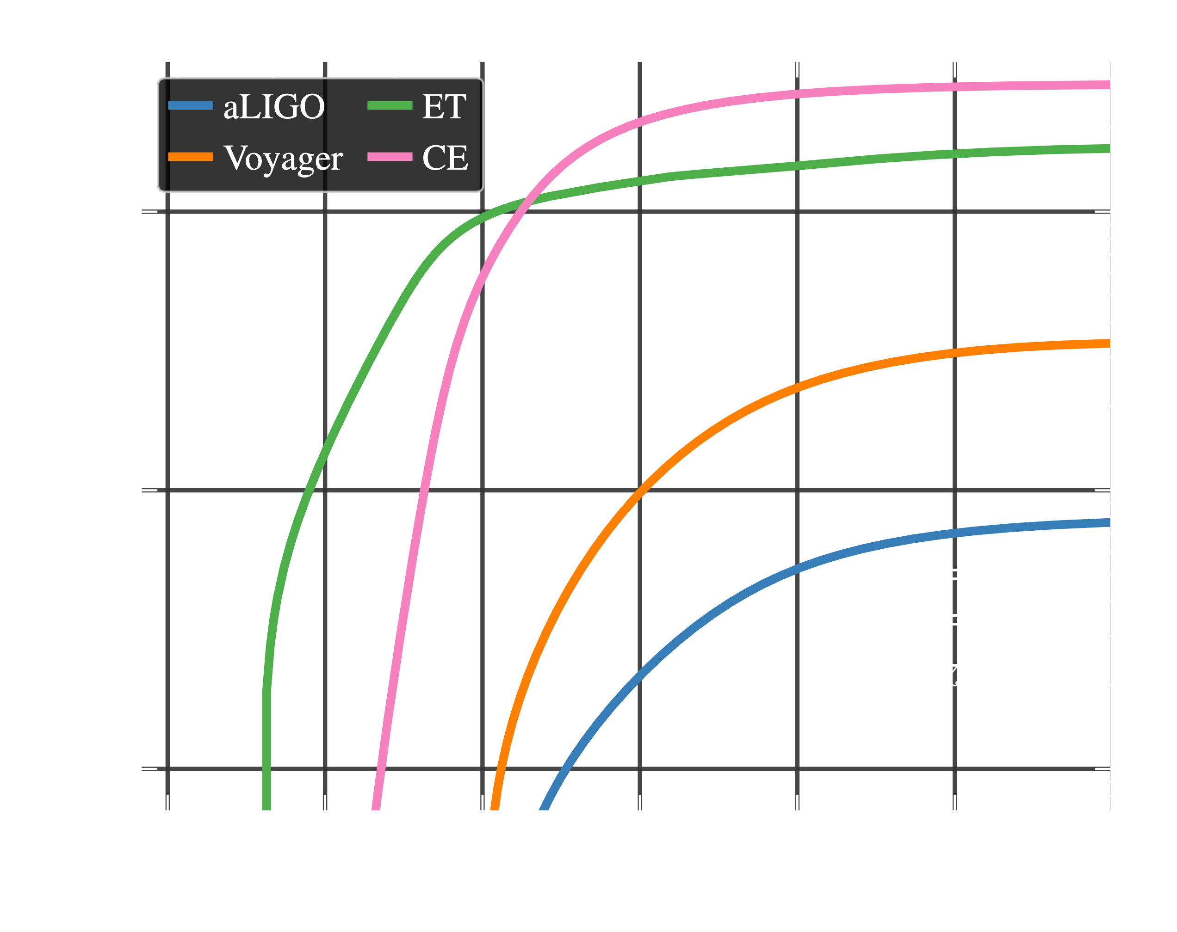
~3 h
~30 min
Credit: Evan Hall
Notes:
Time to optical counterpart for NS-NS binary

Slide 39
Slido for questions
Add your questions or upvote those already posted and I’ll try to answer them.
Fully anonymous!
Slido #921 8346
https://app.sli.do/event/feM5JT34qMLuDUDwBXHDDH

