Slide 1
Instrumentation for gravitational-wave detection
Conor Mow-Lowry
BND School Wuppertal 2023

Slide 2
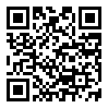
Slido for questions
Add your questions or upvote those already posted and I’ll try to answer them.
Fully anonymous!
Slido #921 8346
https://app.sli.do/event/feM5JT34qMLuDUDwBXHDDH

Slide 3
Session 2
Thinking in the frequency domain
Fourier Transform and its properties
Autocorrelation and spectral densities
‘Building’ a spectrum analyser
Deconstructing the sensitivity curve.
The physical interpretation of the curve
The dominant ‘fundamental’ noises
How to build a noise budget
A brief look at a ‘real’ noise budget

Slide 4
The sensitivity curve

Slide 5
The sensitivity curve in a nutshell
The frequency response of the detector
It tells us that a signal at that level will have Signal to Noise ratio of 1 for a one second measurement period
Since down is better, the plot effectively shows a noise-to-signal ratio
Very useful for characterizing time-invariant gaussian noise
- Not very useful for transients
- Only really valid for linear measurements.

Slide 6
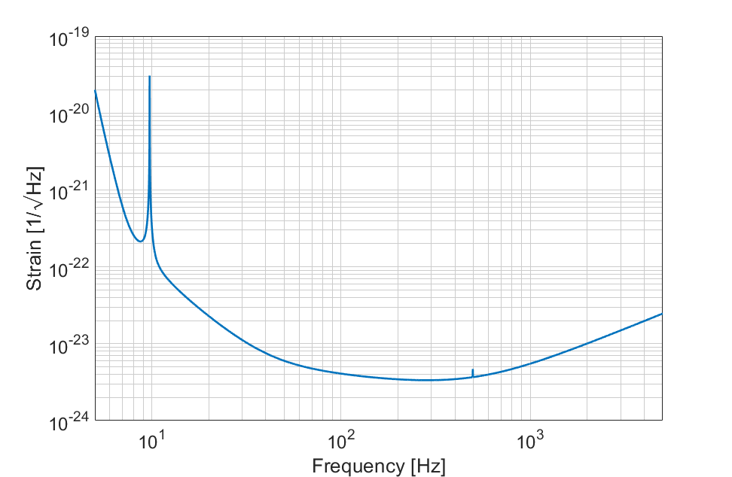
Advanced LIGO design sensitivity
The bare sensitivity curve; used for inferring astrophysical science outcomes.
Strain is $h=\frac{∆L}{L}$
$\frac{1}{\sqrt{Hz}}$ we will get to later.

Slide 7
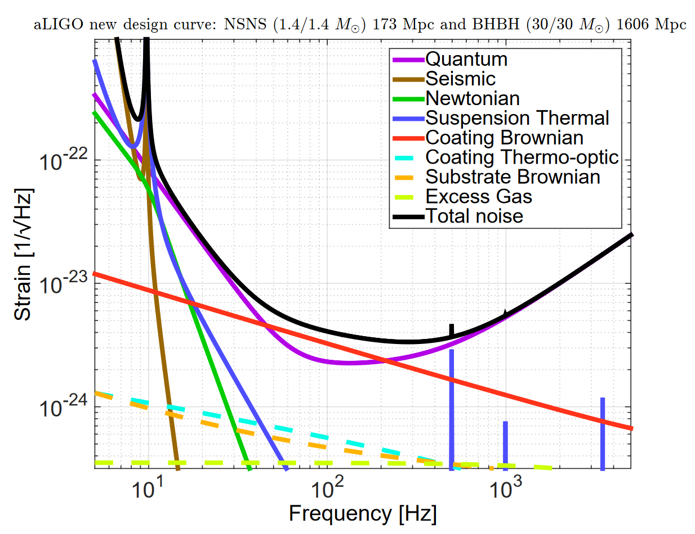
Advanced LIGO design noise budget
The ‘fundamental’ noises that drive major instrument design parameters.
Mostly computed from theory; ‘Newtonian’ and ‘Seismic’ have complex couplings.

Slide 8
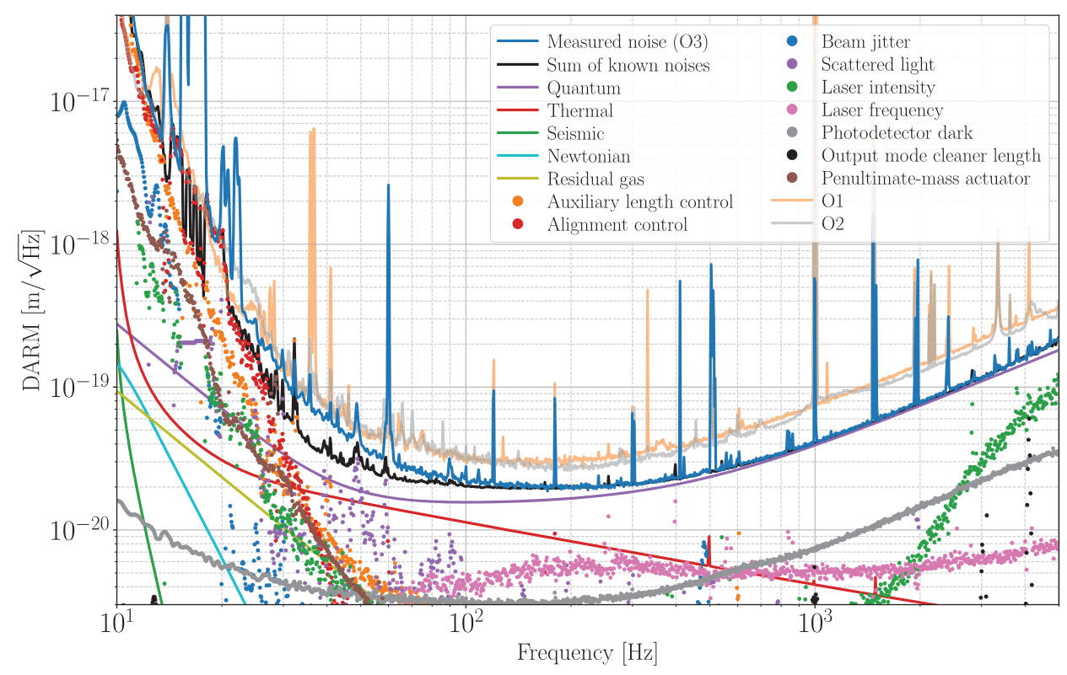
Advanced LIGO ‘real’ noise budget (2020)
🤯
😱
😭
PRD 102, 062003 (2020)

Slide 9
Moving to the frequency domain

Slide 10
Frequency domain
Sinusoidal basis
Linear! A unique basis for solving ODEs
Several important properties of the Fourier Transform
Parseval’s theorem
Energy is conserved
Converting to spectral density and then to amplitude
That pesky square root
(To the whiteboard!)
Honestly, this guy just loves the Fourier transform… https://www.thefouriertransform.com/

Slide 11
Convolution
Visually, the convolution can be seen in the following animations
$$\left(f∗g\right)\left(t\right)= \int_{−∞}^{∞}{f\left(τ\right)g(t−τ)}dτ$$
The integral of a top-hat (or ‘box’) function can readily be seen to be a triangle wave.
The convolution with the top-hat ‘smears’ out the sharp peak in the blue curve. This could be seen as, for example, the finite response time of a measurement apparatus.

Slide 12
Auto/Cross-Correlation + Convolution
https://commons.wikimedia.org/wiki/File:Comparison_convolution_correlation.svg#/media/File:Comparison_convolution_correlation.svg

Slide 13
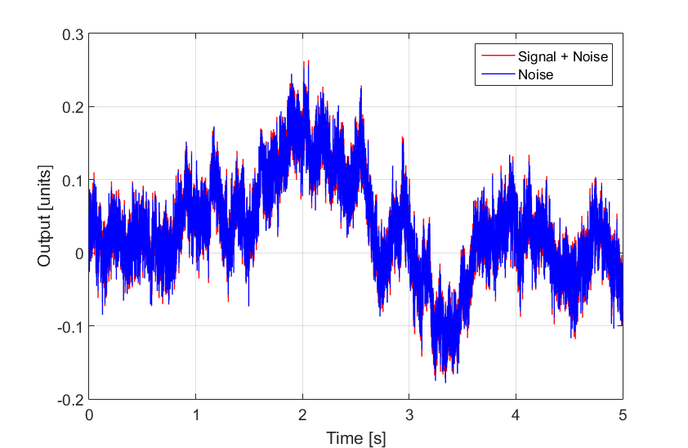
Power of the Spectrum
In the presence of noise, particularly frequency-dependent noise (and nearly all noise has some frequency dependence), the PSD can reveal otherwise invisible signals, and provide numerous other clues to the origins of noise and signals.

Slide 14
Power of the Spectrum
Simply taking the spectrum allows us to clearly see the signal hidden in the noise, with a surprisingly good ‘peak prominence’.

Slide 15
Bonus: the cross-spectral density
Taking the cross-spectral density (FT of the cross-correlation) of the noisy data with our perfect model shows us something even more remarkable.
For continuous, sinusoidal signals this is equivalent to matched-template filtering.

Slide 16
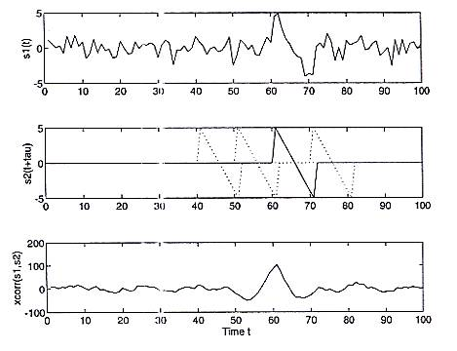
Searching for a signal: cross-correlation
Source: P. Saulson, "Fundamentals of interferometric Gravitationsal Wave Detectors"

Slide 17
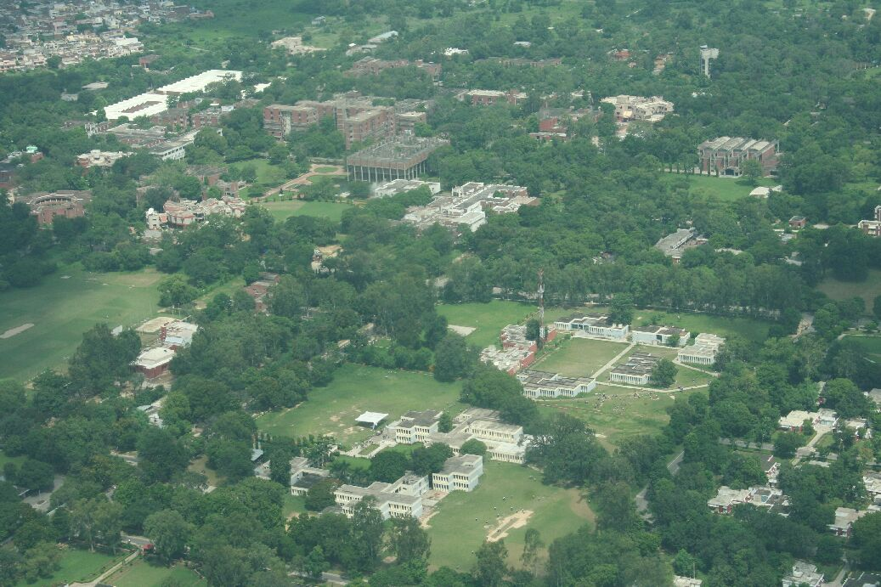
Cross correlation: Template matching
Taken from: http://www.cse.iitk.ac.in/users/sarika/cs676/hw-opencv.html

Slide 18
Cross correlation: Template matching
Taken from: http://www.cse.iitk.ac.in/users/sarika/cs676/hw-opencv.html

Slide 19
Cross correlation: Template matching
Taken from: http://www.cse.iitk.ac.in/users/sarika/cs676/hw-opencv.html

Slide 20
Transfer functions

Slide 21
Frequency domain (#2)
We now know how to show stationary noise in the frequency domain. Why is it always shown in log-log plots?
All out LTI systems that generate or filter noise have responses well characterized by polynomials (or ratios thereof) in the frequency domain…

Slide 22
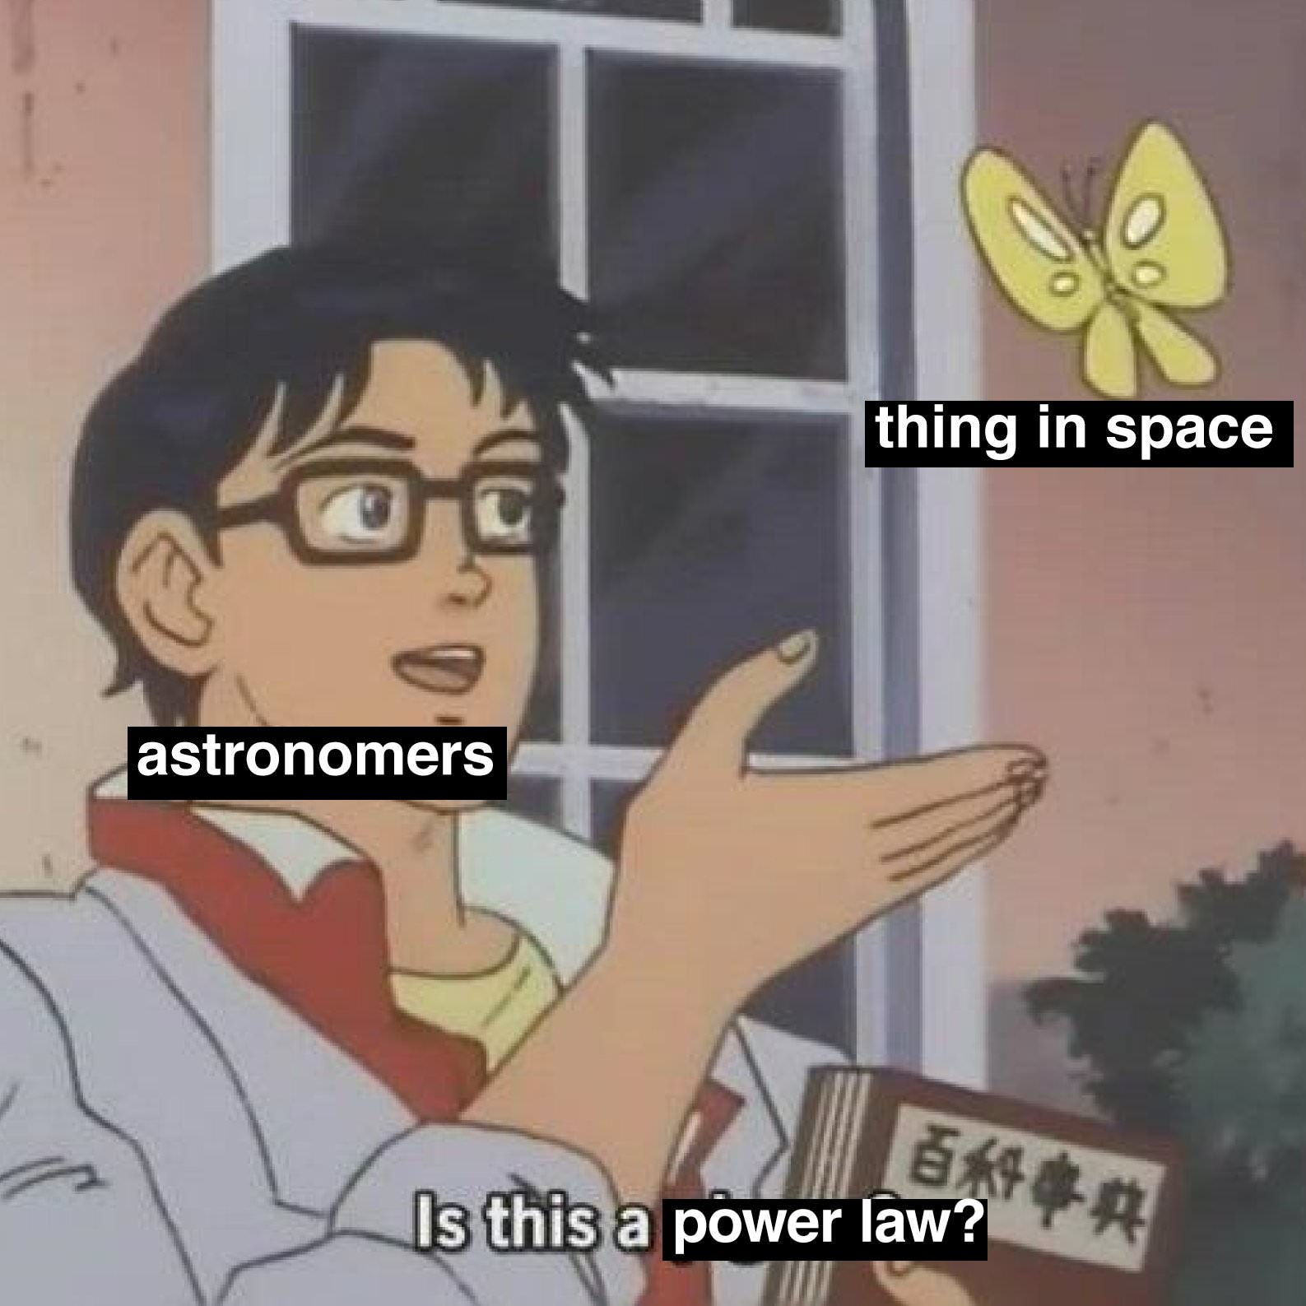

Slide 23
The response of “LTI” systems
Typically expressed using Bode plots showing the power-law behaviour as straight lines
Turns a differential-equation/convolutional process into multiplication (or addition in log-units)
Allows the projection of dissimilar quantities

Slide 24
Building a noise budget

Slide 25
Building a noise budget
First and most important: draw your system block diagram!
Determine the input noise amplitude-spectral-densities.
Calculate or measure the transfer function to the output
Compare grapes with windmills in a sensible way.

Slide 26
Example: Laser frequency noise (tutorial 1)
Sketch experimental apparatus
Derive analytic model
Add perturbative terms for (linear) noise couplings
Calculate transfer function(s)
Tomorrow we will find equations for Watts/radian for a GW event and Watts/Hz for laser frequency noise.

Slide 27
Advanced LIGO design noise budget
Example:
“Excess gas” causes refractive index fluctuations in the beam tubes. This creates a phase shift which can be compared with the GW strain.

Slide 28
Advanced LIGO ‘real’ noise budget (2020)
PRD 102, 062003 (2020)

Slide 29
Conclusions
The opto-mechanical systems in Gravitational-wave observatories are overwhelmingly Linear (LTI) Systems
Instrument science for GWs is predominantly a study of stationary noise sources and their couplings.
The sinusoidal basis (Fourier/Laplace transform) is a natural basis for analysing these systems.
The spectral density is a natural way to display stationary noises, and power-law slopes can indicate their origin.

Slide 30
Slido for questions
Add your questions or upvote those already posted and I’ll try to answer them.
Fully anonymous!
Slido #921 8346
https://app.sli.do/event/feM5JT34qMLuDUDwBXHDDH

