Slide 1
Instrumentation for gravitational-wave detection
Conor Mow-Lowry
BND School Wuppertal 2023

Slide 2
Slido for questions
Add your questions or upvote those already posted and I’ll try to answer them.
Fully anonymous!
Slido #921 8346
https://app.sli.do/event/feM5JT34qMLuDUDwBXHDDH

Slide 3
Session 3
Laser interferometry: Phase to power
Maxwell’s equations to the wave equation
Plane waves and simplifications
Measuring a laser beam and our simplest nomenclature
Tutorial 1:
Calculate the response to a gravitational wave
Project laser frequency fluctuations into ‘strain equivalent’ noise.

Slide 4
Tutorial material
Morning BND tutorial 1 – frequency noise (indico) Diagram on slides (on screen + indico)
(helpful) BND session 3 Maxwell_to_detection (indico) (optional) Session 3 notes - interferometer_techniques…
Afternoon BND tutorial 2 – sensor_response (indico) BND tutorial 2 notes – thermal noise (indico) Information on slides (on screen + indico)
(optional) BND tutorial 2 notes – pole_zero (indico)

Slide 5
Maxwell to Measured power
(in the Maxwell_to_Detection pdf)

Slide 6
A Michelson interferometer

Slide 7
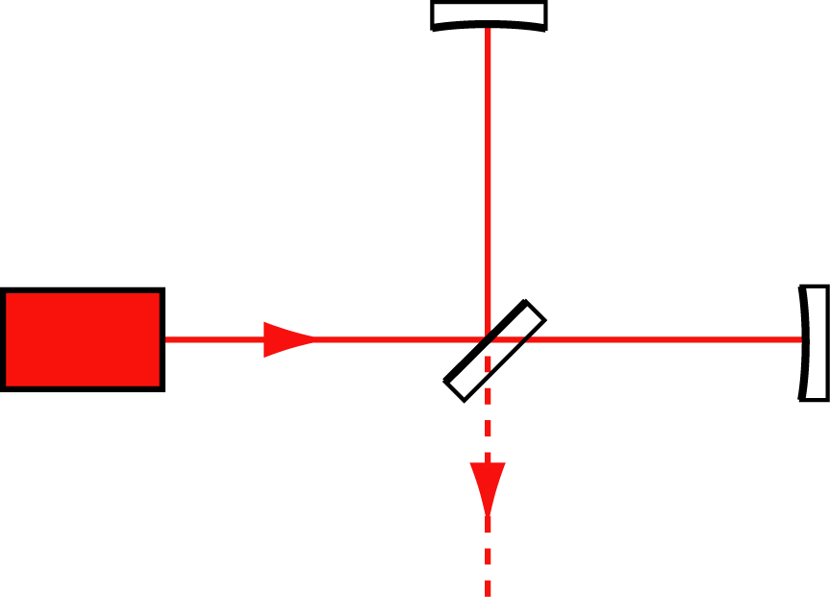
Michelson Interferometer
δL_{d}/2
L₁
Laser
δL_{d}/2
P_{in}
L₂
k₀ + δk
P_{out}

Slide 8
Beamsplitter
E_{r} = r.E_{in}
E_{in} = √P_{in}
E_{t} = it.E_{in}
R = T = 0.5
r = t = √0.5

Slide 9
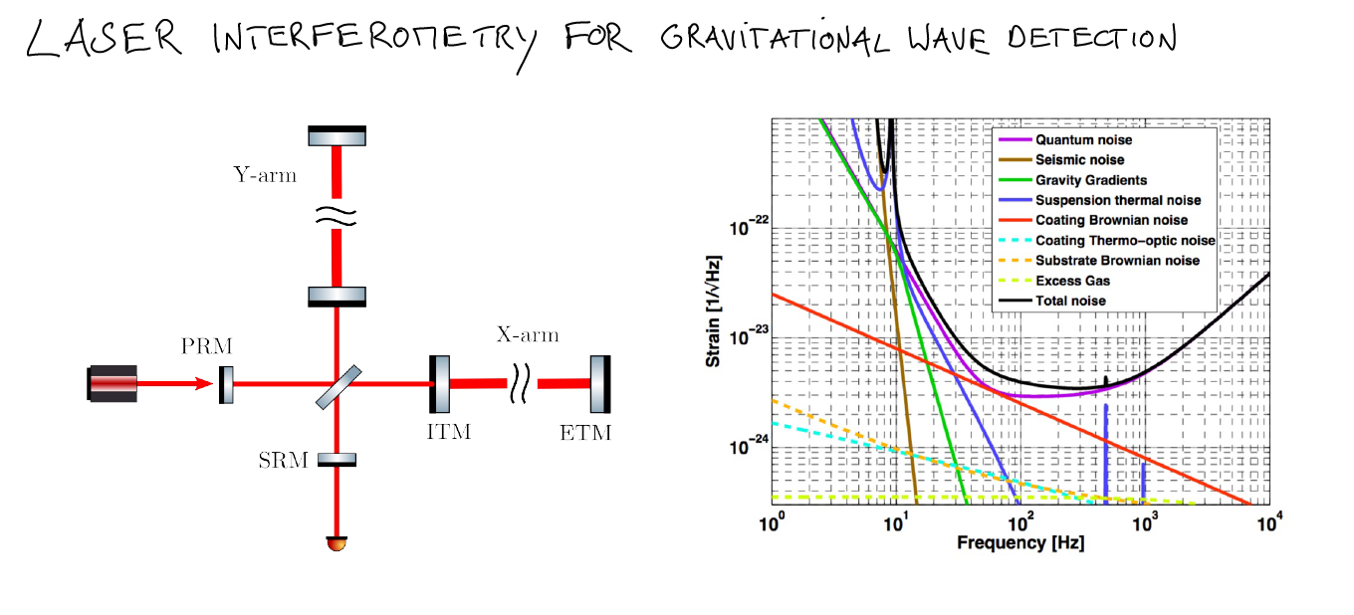
From Andreas Freise’s notes, 2022 BND school

Slide 10
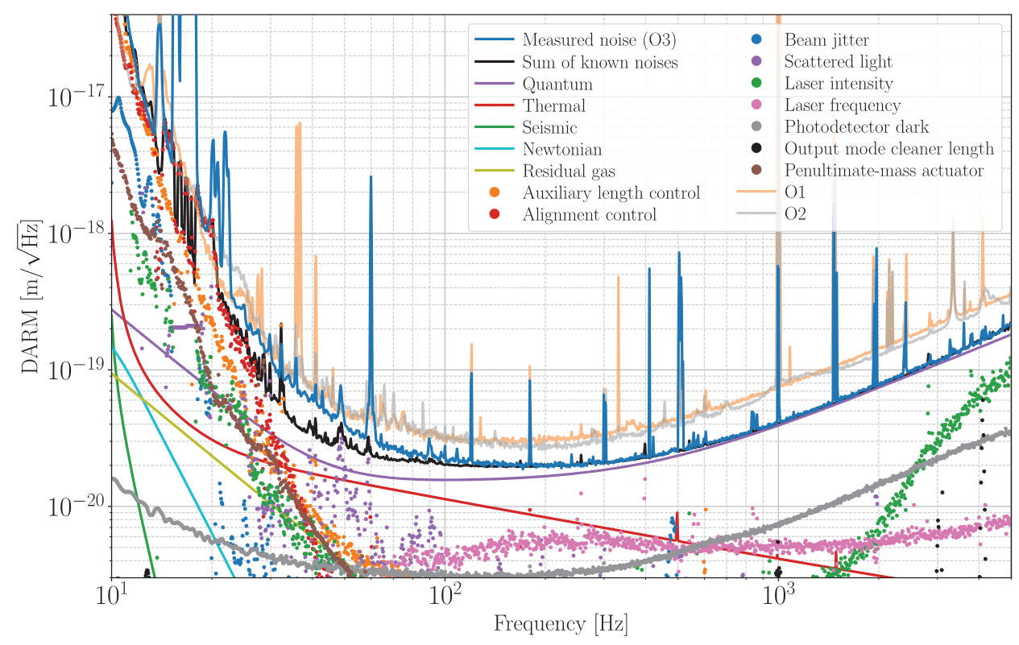
Advanced LIGO ‘real’ noise budget (2020)
PRD 102, 062003 (2020)

Slide 11
Conclusions
These simple, algebraic computations form the basis of interferometer simulation tools.
They determine the optical response of the detector and they are used extensively in the design phase
They must be augmented with an understanding of the actual beam shape, size, and alignment.
The derivation you have made is sufficient for understanding frequency fluctuations (Hz) to measured power (W), but not for Gravitational Wave (strain) to power.

Slide 12
Slido for questions
Add your questions or upvote those already posted and I’ll try to answer them.
Fully anonymous!
Slido #921 8346
https://app.sli.do/event/feM5JT34qMLuDUDwBXHDDH

