Slide 1


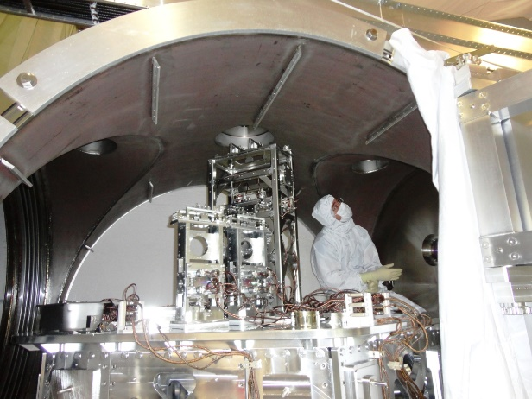
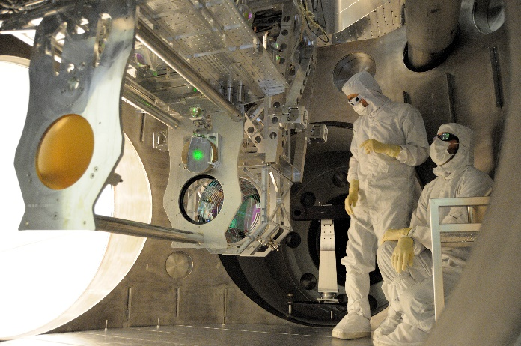
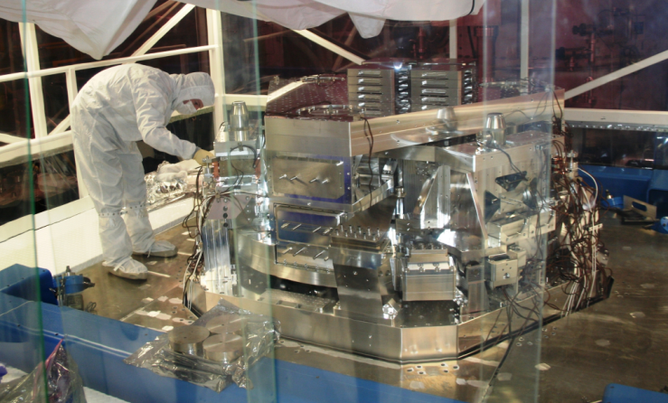
Seismic Noise and LIGO
Why the biggest noise source isn’t the baddest
Conor Mow-Lowry

Slide 2
Session 4
Seismic noise
  Physical origins
  Passive isolation
  Inertial sensors
Tutorial 2: Mechanics in the frequency domain.
  Calculate the response of a seismometer
  Build a noise budget with readout noise and thermal noise.

Slide 3

Slido for questions
Add your questions or upvote those already posted and I’ll try to answer them.
Fully anonymous!
  Slido #921 8346
  https://app.sli.do/event/feM5JT34qMLuDUDwBXHDDH

Slide 4
Tutorial material
Morning BND tutorial 1 – frequency noise (indico)
Diagram on slides (on screen + indico)
(helpful) BND session 3 Maxwell_to_detection (indico)
(optional) Session 3 notes - interferometer_techniques…
Afternoon BND tutorial 2 – sensor_response (indico)
BND tutorial 2 notes – thermal noise (indico)
Information on slides (on screen + indico)
(optional) BND tutorial 2 notes – pole_zero (indico)

Slide 5
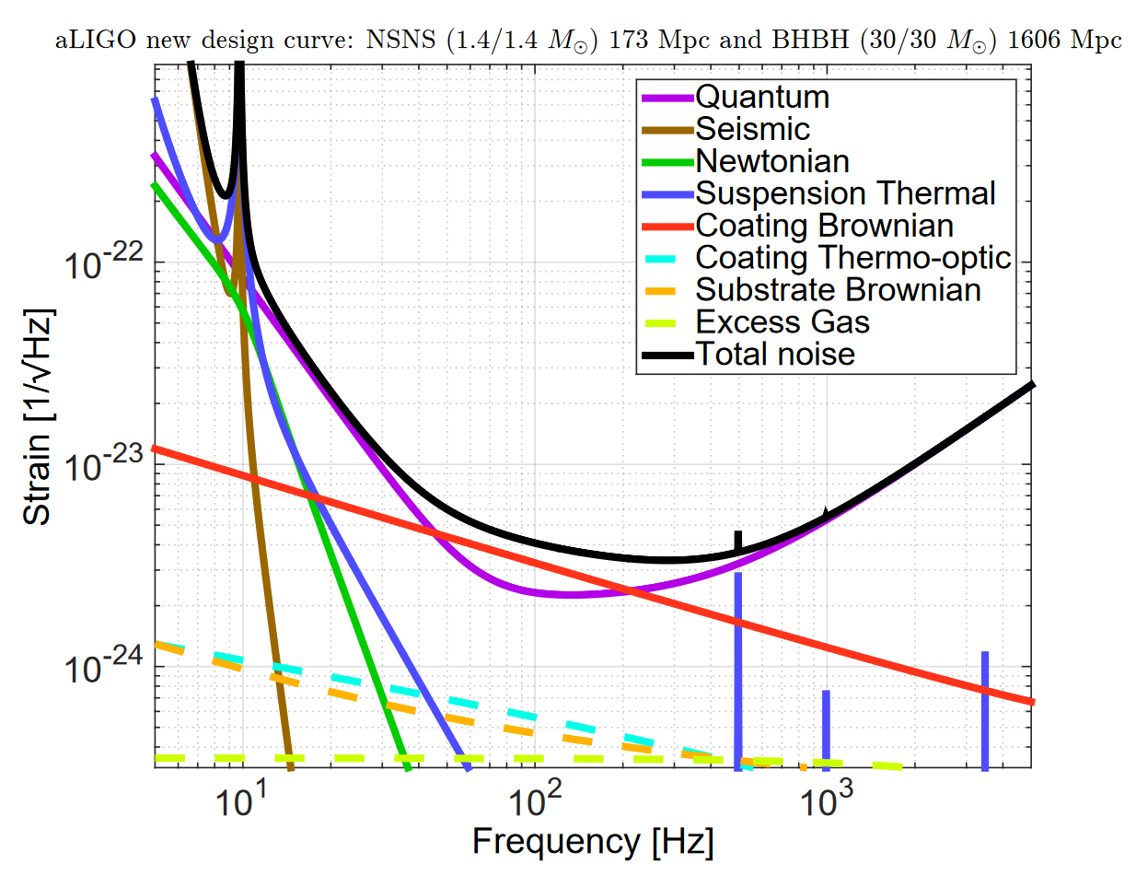
Just how big is ‘big’?
Here be dragons!

Slide 6
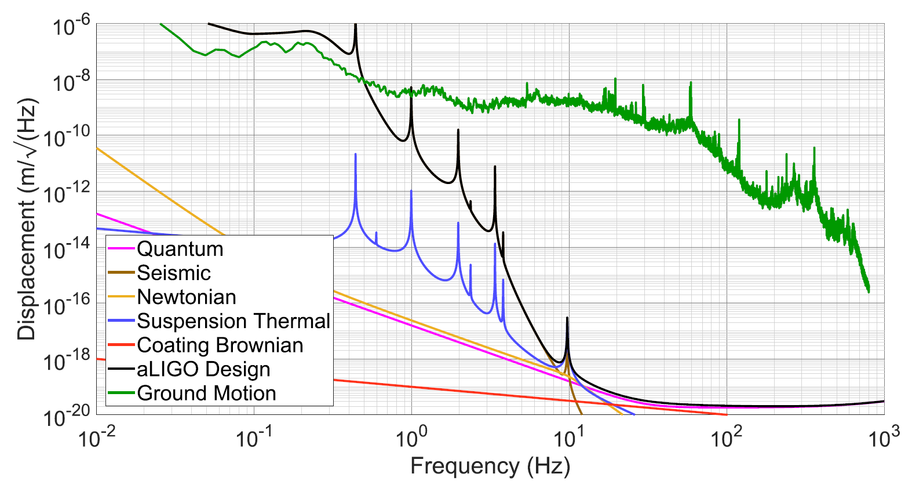
Just how big is ‘big’?
Factor of 10¹⁰!
Sam Cooper, PhD thesis, available at:
https://core.ac.uk/download/pdf/286186961.pdf

Slide 7
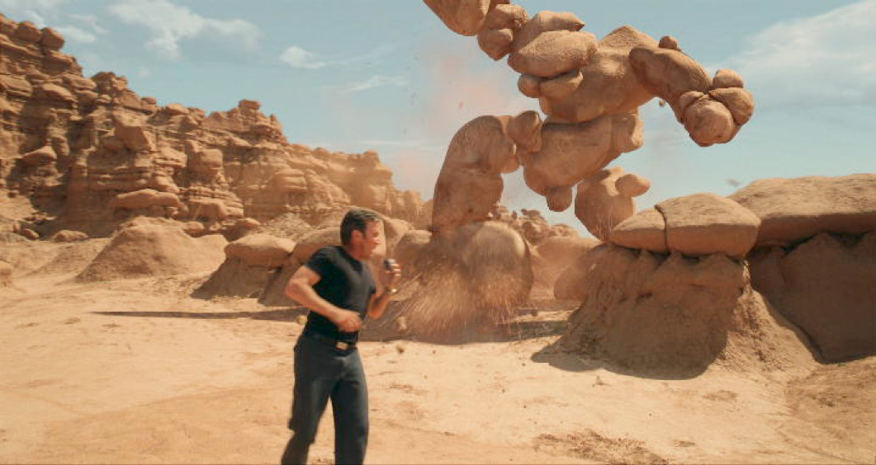
Part 1: Seismic noise
Galaxy Quest

Slide 8
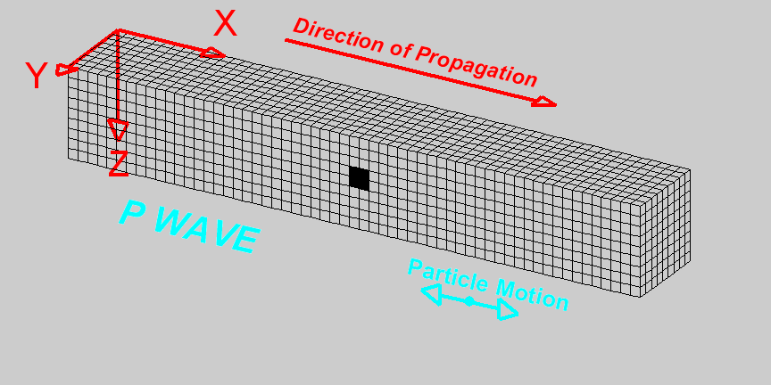
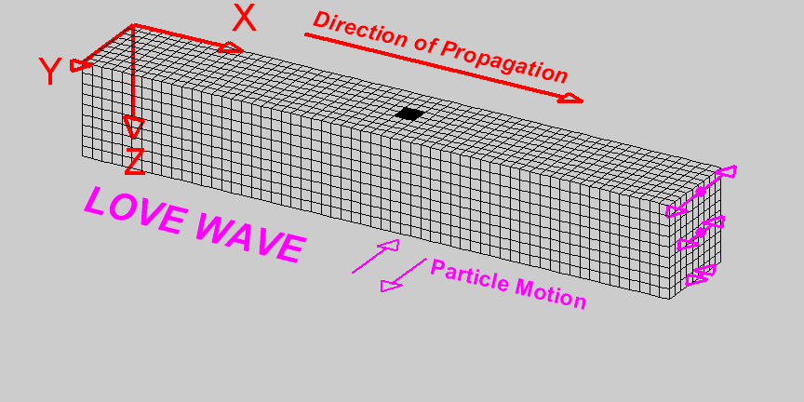
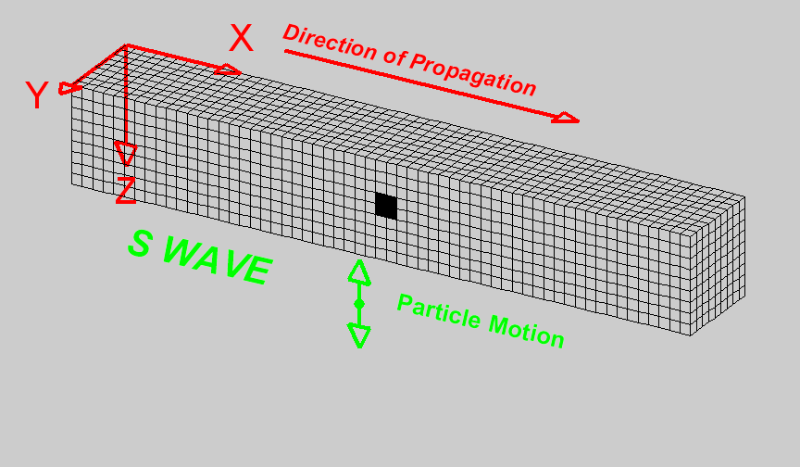
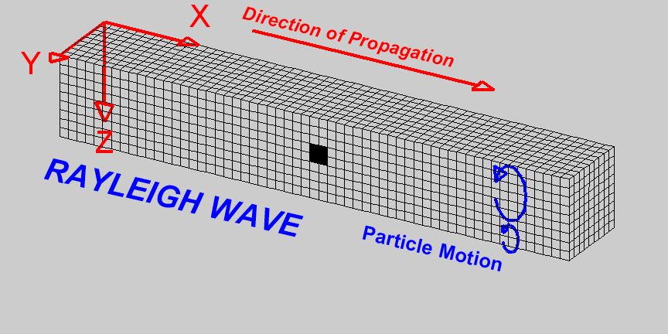
Seismic noise: Surface waves
Microseisms: below 1 Hz
  Ocean waves interacting
  with seafloor
    Primary microseism (0.07 - 0.1 Hz)
    Secondary microseism (0.14 - 0.2 Hz)
Microtremors: above 1 Hz
  Human-made vibrations:
    Buildings
    Cars
    Machinery
  Environmental vibrations
P-wave
Pressure wave
Primary wave
Love wave
Particle motion
Particle motion
S-wave
Shear wave
Secondary wave
Rayleigh wave
Particle motion
Particle motion
www.geo.mtu.edu/UPSeis/

Slide 9
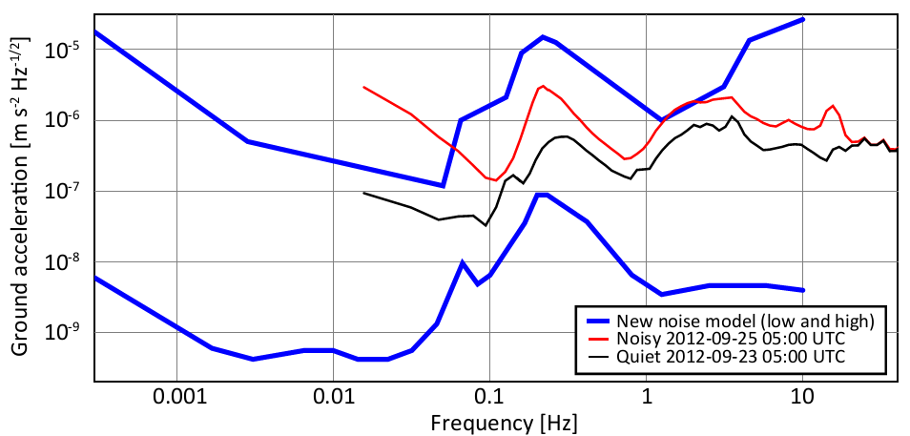
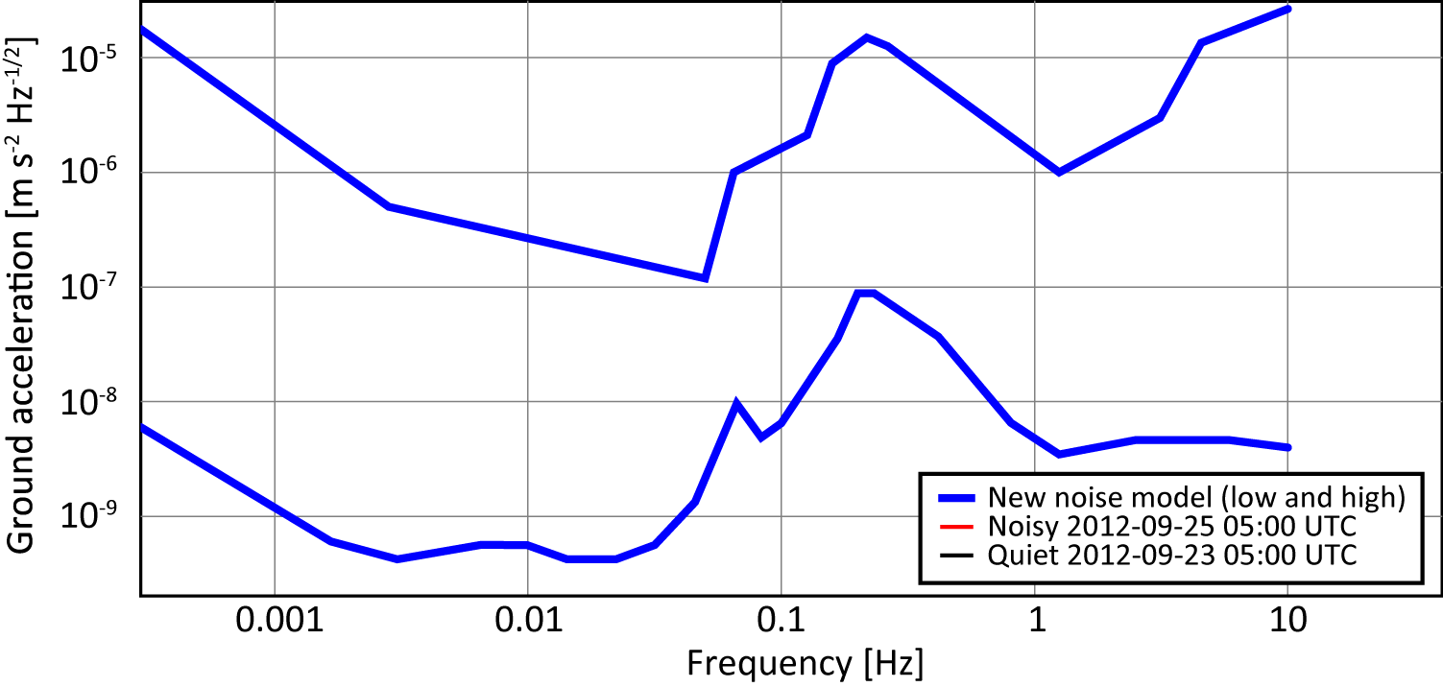
Seismic noise model
Microseisms
Microtremors
Frequency [Hz]
Time [s] 1000 100 10 1 0.1

Slide 10
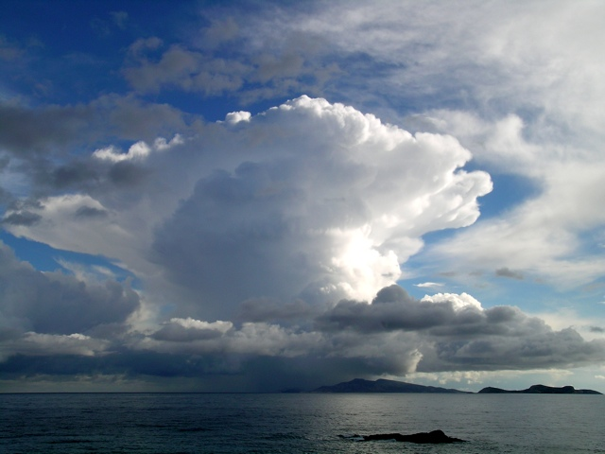



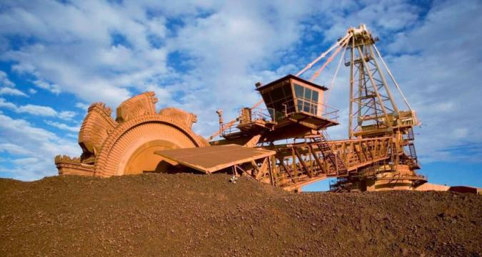
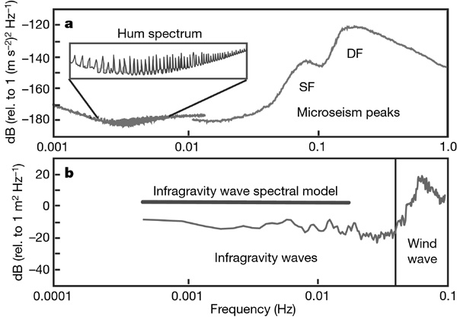
Seismic noise model
Ground tilting
Human activity
Secondary microseism
Primary microseism
Earth‘s hum
Frequency [Hz]
Time [s] 1000 100 10 1 0.1
[Peterson 1993 OBSERVATIONS AND MODELING OF SEISMIC BACKGROUND NOISE]
[Nature2007 V.445 Nr.7129 pp754-756]
doi:10.1038/nature05536
Notes:
The Earth responds to the Moon - Earth Tides
the surface of the solid earth moves only about 10 cm at most;
"normal modes" or "free oscillations"
In 1911 A.E.H. Love made the calculations and determined the period would be about an hour.
he first real proof came in 1961 by Bruce Bolt who clearly identified a 54 minute mode associated with the 1960 Chilean earthquake. He also saw much shorter period vibrations that represent harmonics or overtones of the fundamental long period mode.

Slide 11
Seismic noise model
Measured in the
AEI basement
Earthquake
Microseismic peak
Human activity
Frequency [Hz]
Time [s] 1000 100 10 1 0.1

Slide 12
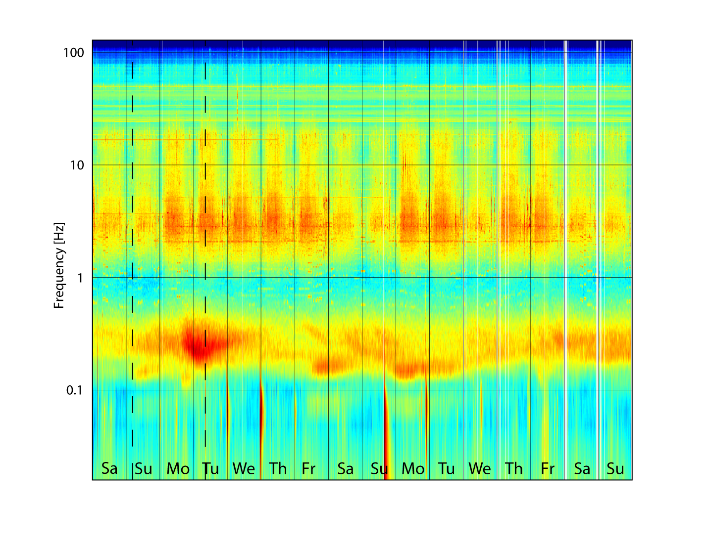

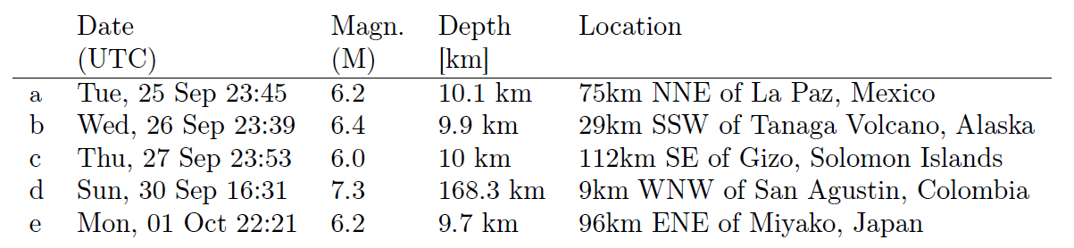
Spectrogram of the ground velocity
Measured in the
AEI basement
Quiet
Noisy
Weekend
Holiday
Motors
Human
activity
Tue, 25 Sep 05:37 5.2 565 km 405 km S of the Fiji Islands
Earthquakes
2012-09-22
2012-10-03
2012-10-07
http://www.volcanodiscovery.com/earthquakes/archive/

Slide 13
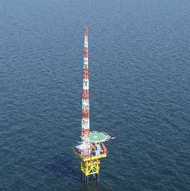
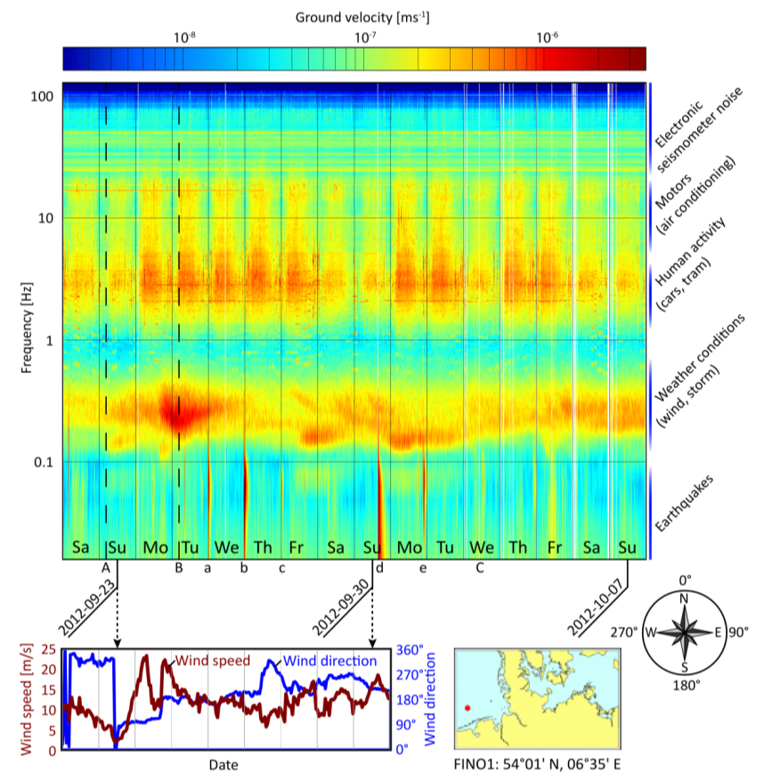
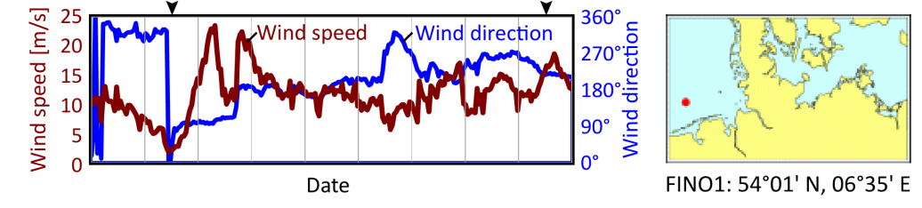
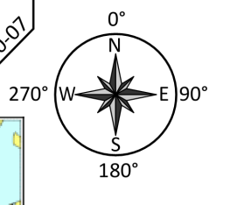
Spectrogram of the ground velocity
Research platform FINO1
(Forschungsplattformen
in Nord- und Ostsee)
45 km from Borkum
Quiet
Noisy
Weekend
Holiday
Motors
Human
activity
Weather conditions
Earthquakes
The meteorogical data are courtesy of the
Bundesministerium für Umwelt, Naturschutz und Reaktorsicherheit
and the Projektträger Jülich
2012-09-22
2012-10-03
2012-10-07

Slide 14

Part 2: Seismic isolation techniques
Seismic noise: you shall not pass!
LOTR

Slide 15
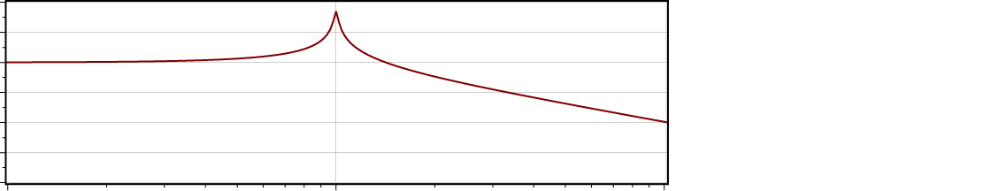
Harmonic oscillator: pendulum
IN
OUT
40
20
0
-20
-40
Transfer function [dB]
Transfer function =
OUT
IN
0.1 1 10
Frequency [Hz]

Slide 16
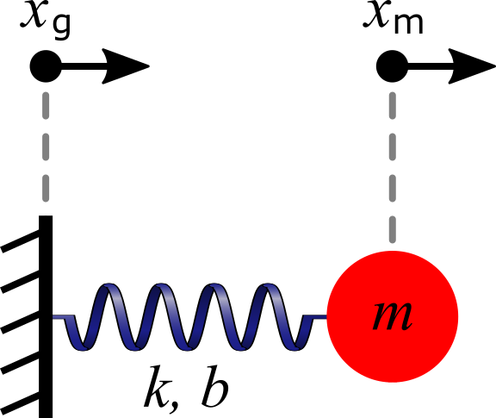
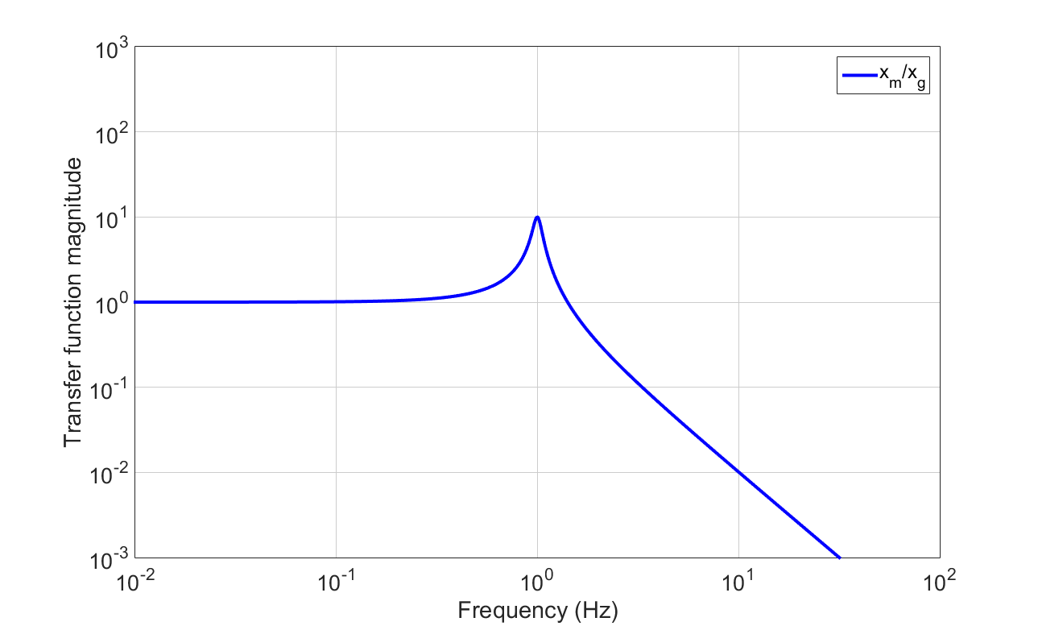

A mass on a spring
$$f_{0}=\frac{1}{2π}\sqrt{\frac{k}{m}}$$
‘roll off’
1/f²

Slide 17

Train suspension
…it’s just a mass on a spring

Slide 18


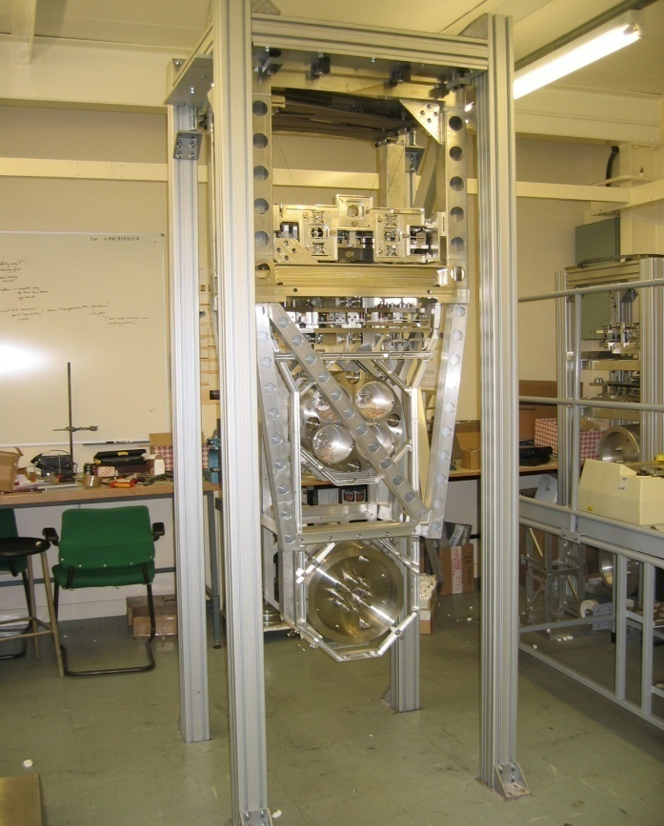
Test Mass Isolation for Advanced LIGO
Prototype quad pendulum for Advanced LIGO
K1
K1
L1
0.5M
K2
K2
L2
≈2 m
0.5M
K3
K3
L3
M
Test Mass
K4
K4
L4
M = 40 kg
M
Credit: Brett Shapiro

Slide 19
Quadruple Pendulum (Quad) Isolation
x₄(s)/x_{g}(s)
x_{g}(t)
K1
K1
0.5M
K2
K2
steep roll off!
Isolation at 10Hz
1/f⁸
0.5M
-140db = 10^{-140/20}
K3
K3
= 10⁻⁷
We need more!
M
GWs this way
K4
K4
M
x₄(t)
Credit: Brett Shapiro

Slide 20
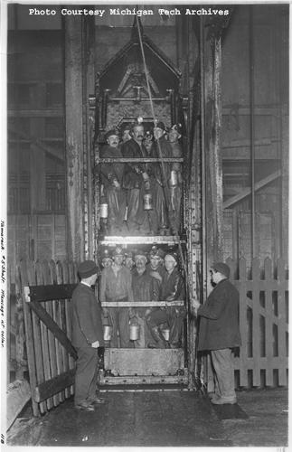
Longest pendulum in the world
http://www.guinnessworldrecords.com/records-1/longest-pendulum/
Tamarack mine shaft,
Michigan (1901)
Payload: 22.7 kg (50 pounds)
Steel piano wire
  Length: ~1,3 km
  Ø 0.55 mm
  Wire streched by 4.5 m
  (15 feet)
Period: 70 s (14 mHz)

Slide 21
We need an extra step
We can’t go ‘taller’, very poor scaling
We can’t just add more stages, poor scaling and increased complexity
We add ‘pre-isolation’
Employ anti-springs to lower resonant frequencies
Use active feedback to damp and suppress motion

Slide 22
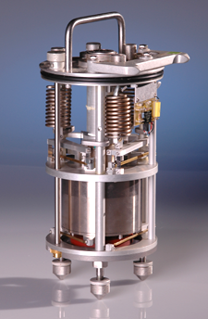
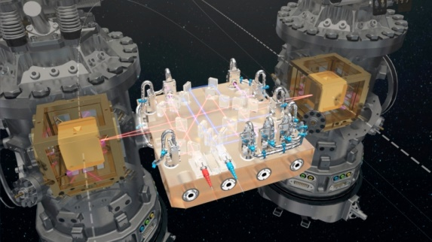
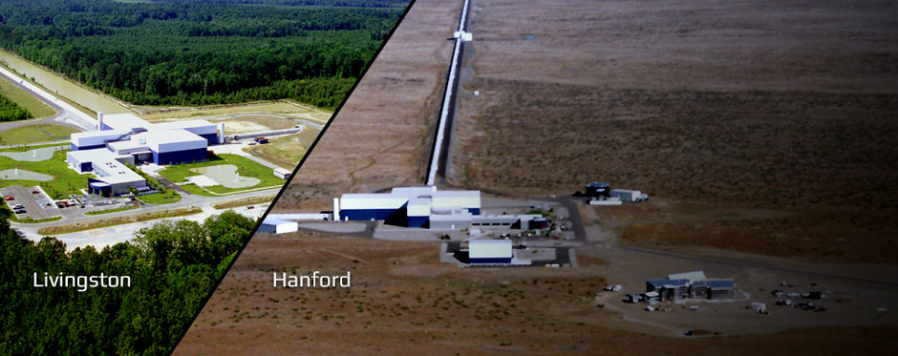
We need an inertial sensor
“Something that measures the motion of an object relative to a free mass”
Special relativity says there is no preferred frame, and our free-mass (or proof-mass) has an undefined position and velocity.
Some examples:
  LISA Pathfinder
  LIGO
  Big-G experiments
  Seismometers
  Every (smart) phone!

Slide 23
A mass on a spring
$$f_{0}=\frac{1}{2π}\sqrt{\frac{k}{m}}$$
‘roll off’
1/f²

Slide 24
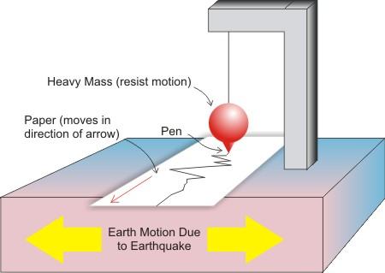
The simplest concept
A mass on a spring (or a pendulum)

Slide 25
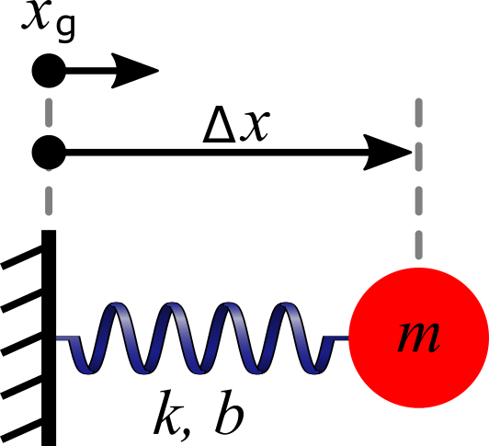
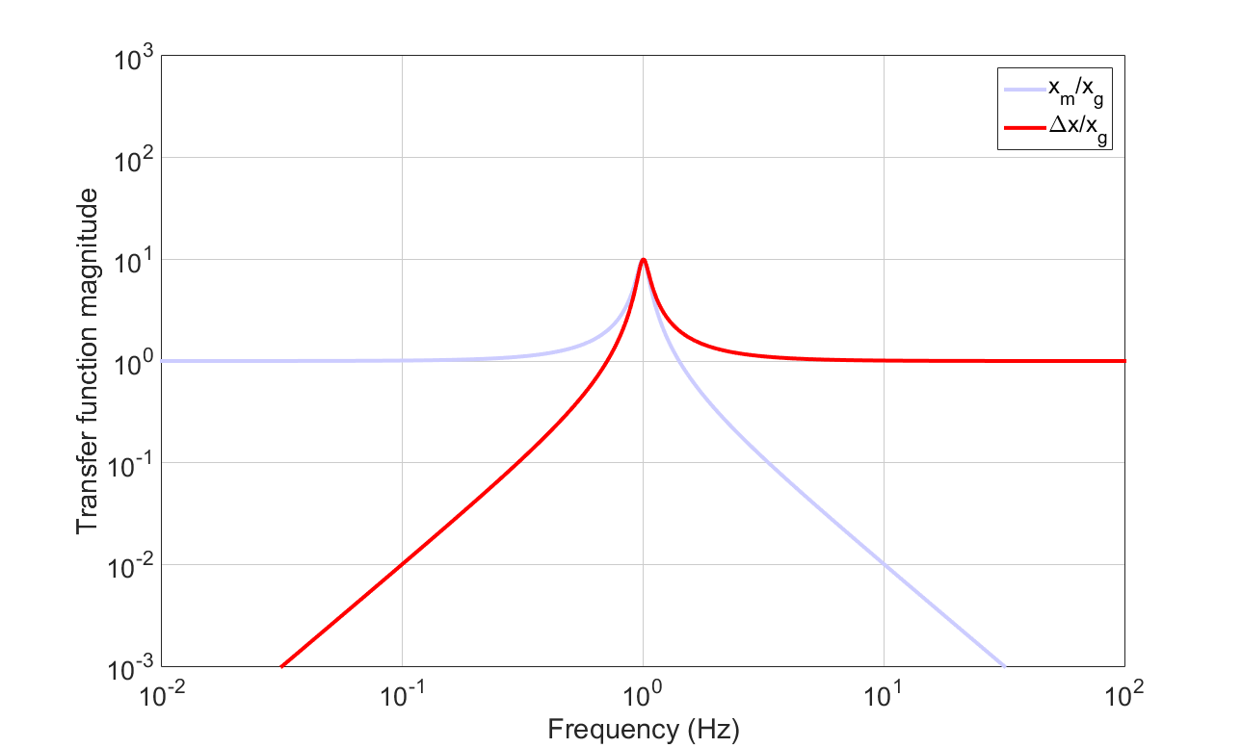
Sensor response

Slide 26
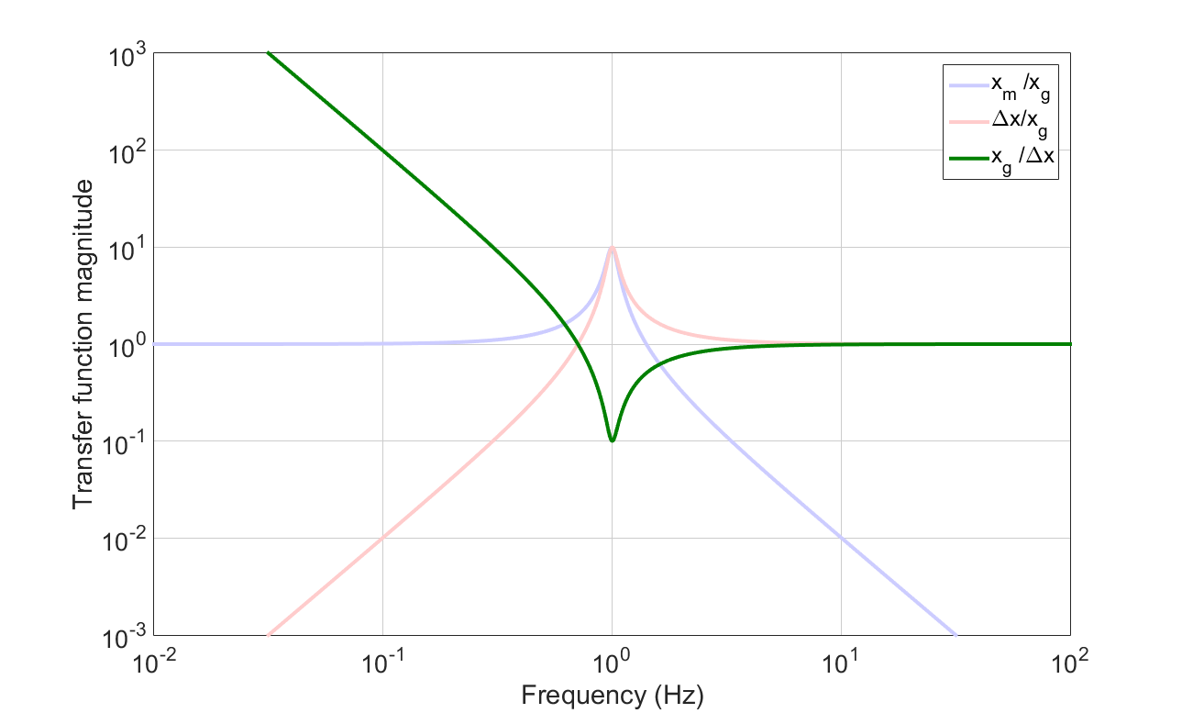
Plant inversion
Converting a relative position into an inertial output results in unbounded noise at low-frequency

Slide 27
An ‘ideal’ inertial sensor
An ‘Ideal’ sensor has no readout noise (or actuation noise, or temperature coupling…), it is limited by force noise.
The lowest limit is suspension thermal noise: approximately white in force noise
More bending material → more loss → more noise.
But enough material is required to support a given mass

Slide 28
Tutorial process
Calculate force noise from the spring
Apply force noise to the mass position, x_{m}
Measure ∆x with a sensor
Apply sensor noise
Convert ∆x to x_{g},
‘plant inversion’
Plot sensing noise
and thermal noise

Slide 29
Tutorial Question!
[optional] Derive the response of a seismometer.
Plot the sensitivity transfer function [m/m] for an example seismometer with m=5kg, f₀=1Hz, Q=40.
Plot the sensitivity to ground motion if you use a displacement readout with a noise floor of 10⁻¹³m/sqrt(Hz)
Compare with a velocity readout with 3x10⁻¹¹m/s/sqrt(Hz).
Plot freq. vs disp. on log-log axes from 10mHz to 10Hz.
Add its suspension thermal noise to the plot. This is now a noise budget for your seismometer!

