Slide 1
A RIVETing journey:
Analysis Preservation and Generator Tuning in High Energy Physics
Johannes Albrecht, Hans Dembinski, Lars Kolk
Workshop on the tuning of hadronic interaction models
Wuppertal, 24.01.2024

Slide 2
Motivation
  Goal: Make paper results more accessible/usable
    Make results publicly accessible
    Provide results in machine readable format
    Provide interface for generator tuning
  Archiving published analyses for public access
    Promotes transparency and reproducibility
    Increases impact of the analysis/paper
    Improves utilisation of analysis for generator tuning
  Analysis preservation
    Data: HEPdata
    Analysis Code: Rivet
LHCb Collaboration, JHEP 01 (2022) 166

Slide 3
HEP Generator tuning in a nutshell
Accelerator data
Tuning software
RIVET
Event generator with tuning interface
Modified from H. Dembinski

Slide 4
Analysis Preservation Roadmap
Publish Analysis
Initiate HEPData submission
Use HEPData output to develop RIVET plugin
Internal Reviews/Merge into Rivet
???
Profit!

Slide 5
HEPDATA

Slide 6
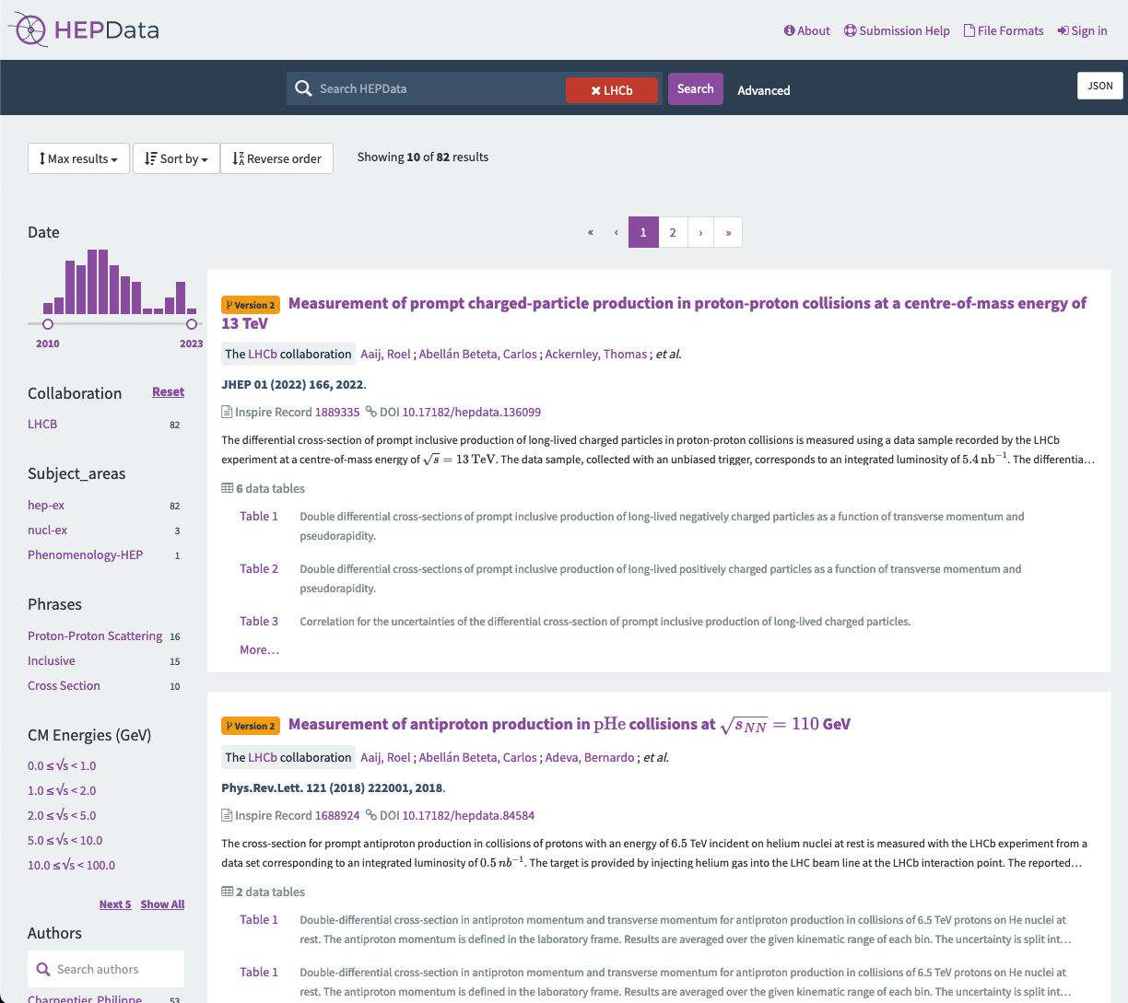
HEPData
HEPData: Open-access repository used to preserve and share experimental data
  Maintained by CERN
  Huge catalogue of preserved analyses
  Ensures long-term preservation of experimental results
HEPData Entries
  Can be searched via many categories
  Come with abstract and proper citation
  Store data in tables

Slide 7
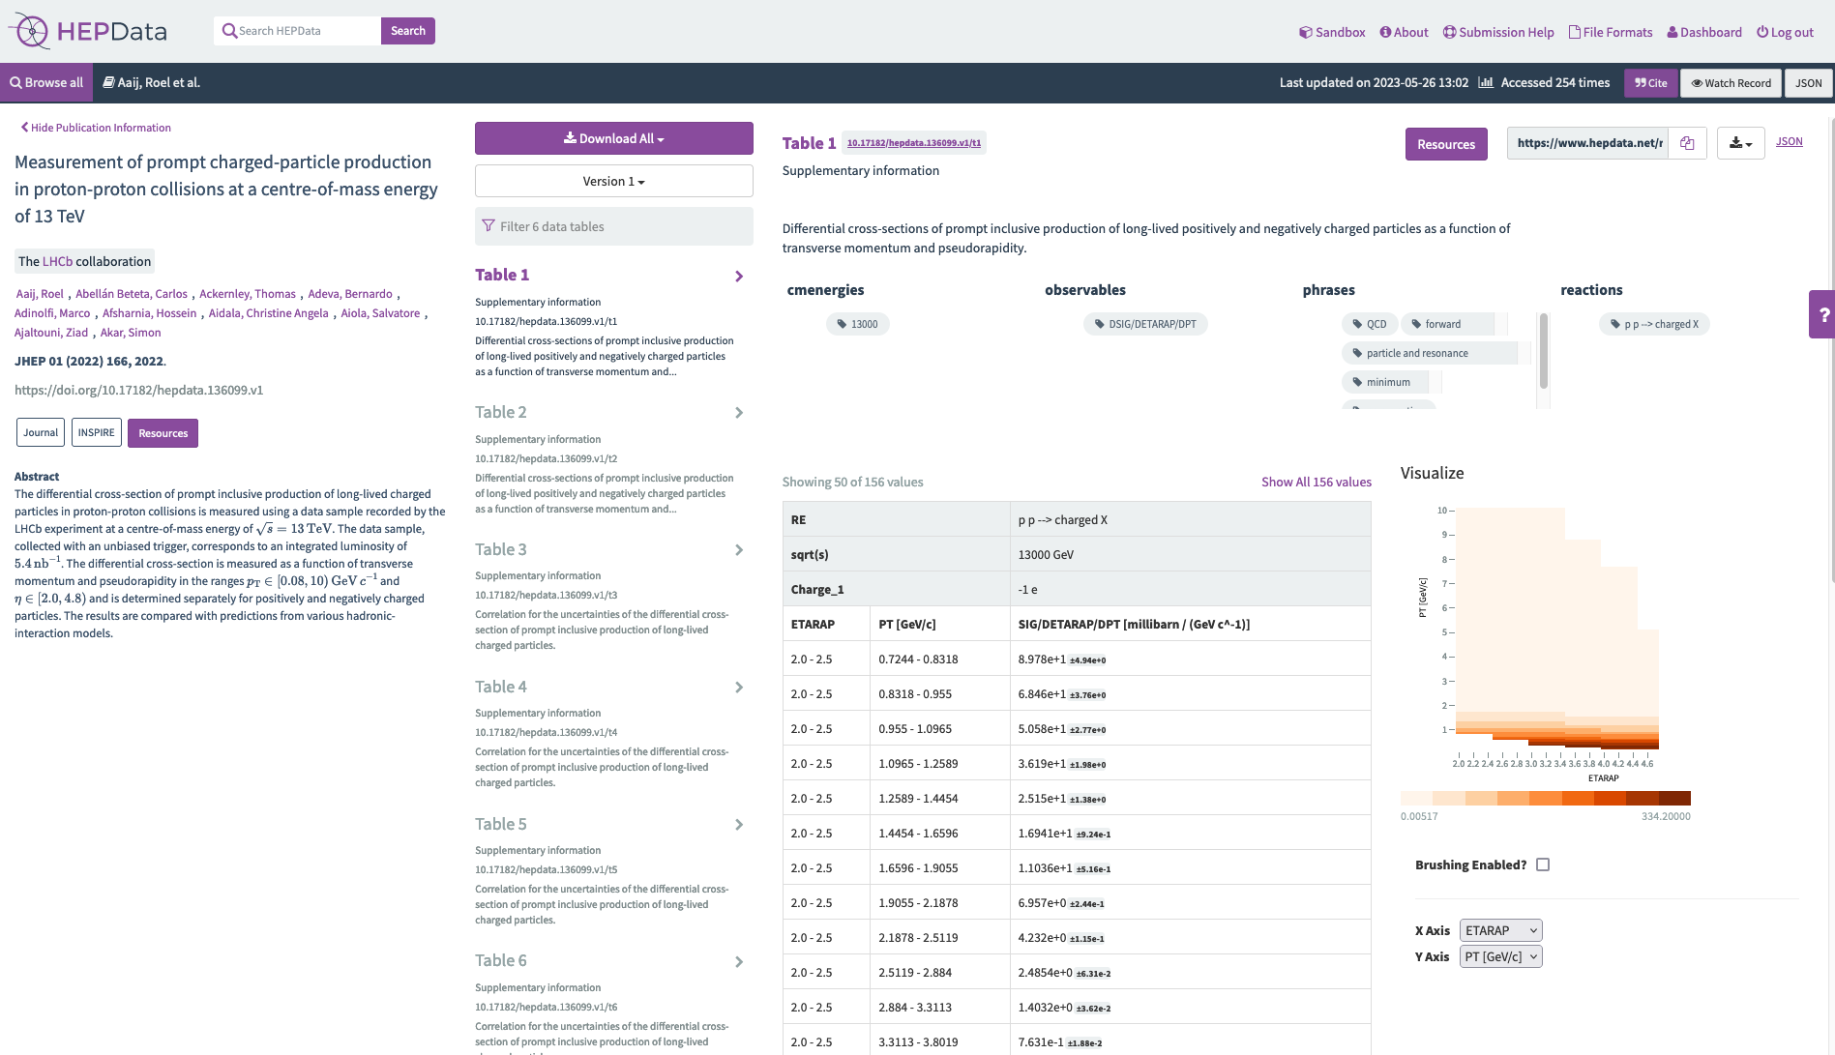
Example HEPData entry

Slide 8
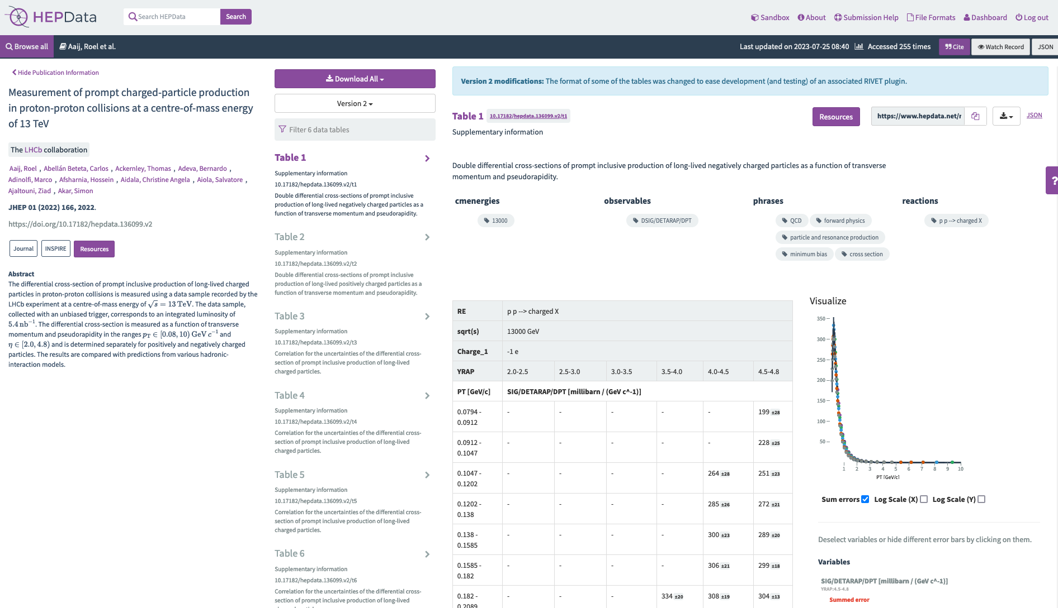
Example HEPData entry

Slide 9
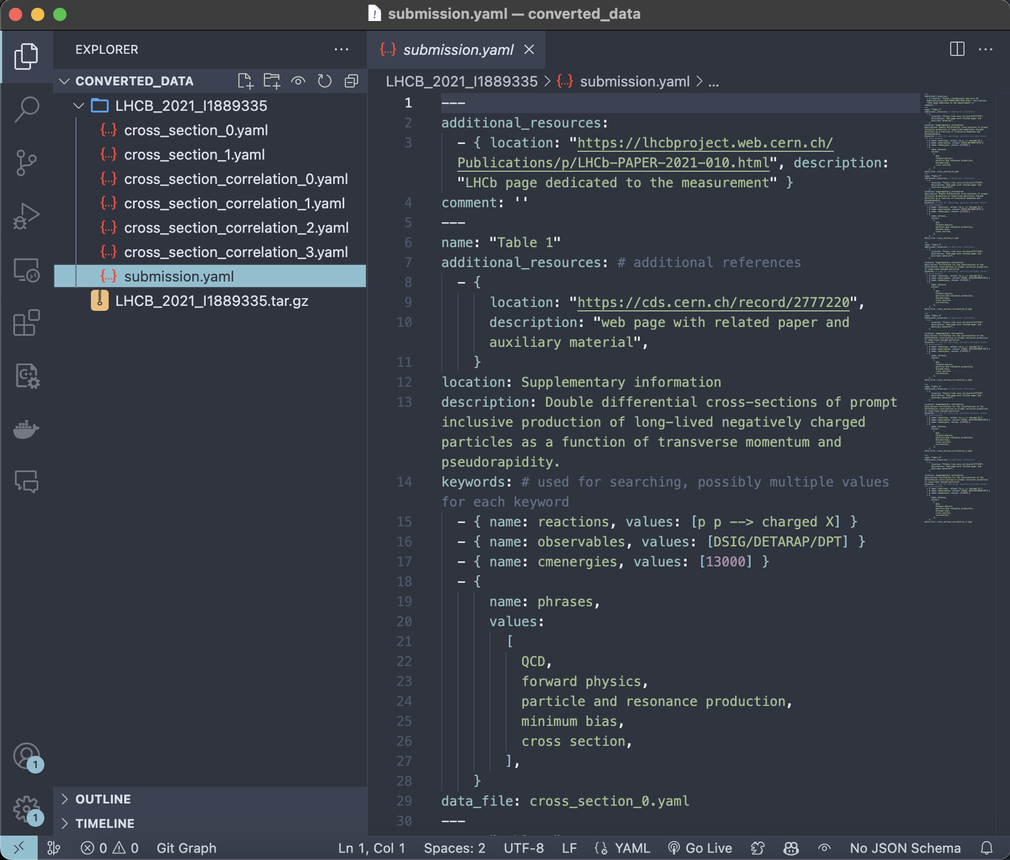
HEPData-Submissions
Each submission consists of …
One submission.yaml
  Links to every table in the submission
  Provides metadata for the HEPData entry
One .yaml file for every table in the entry
  Contain data points, errors
Refer to documentation or previously uploaded entries : )
Contact your coordinator to initiate a submission
Use hepdata-validator or HEPData sandbox to validate your files

Slide 10
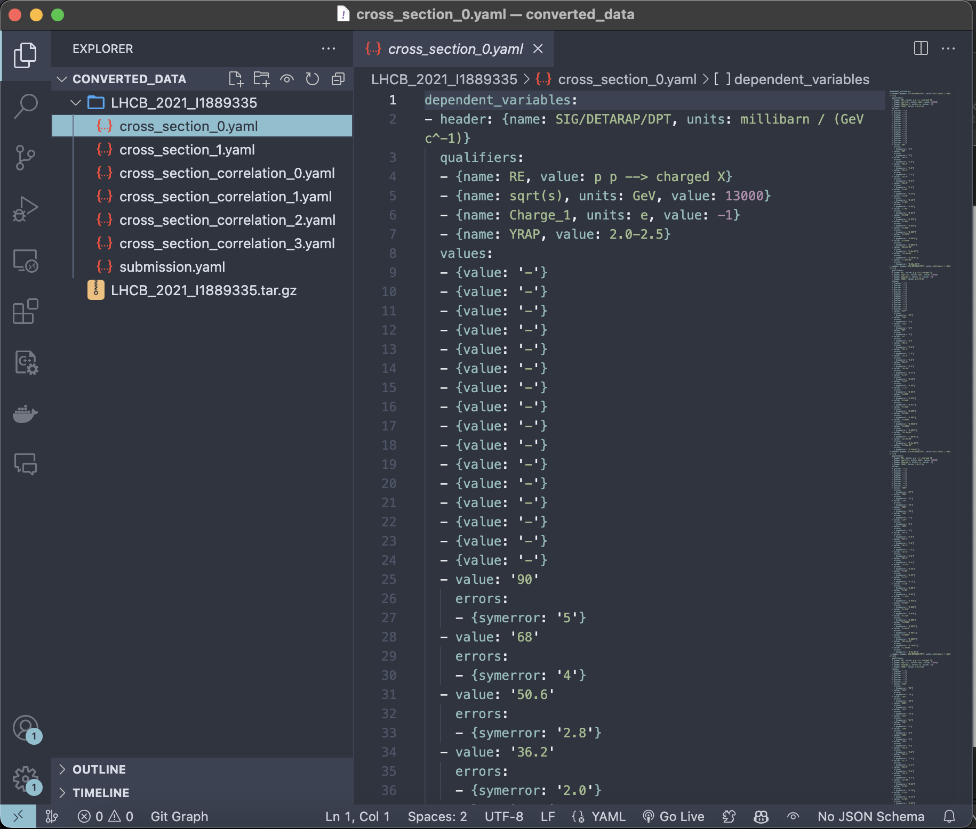
HEPData-Submissions
Each submission consists of …
One submission.yaml
  Links to every table in the submission
  Provides metadata for the HEPData entry
One .yaml file for every table in the entry
  Contain data points, errors
Refer to documentation or previously uploaded entries : )
Contact your coordinator to initiate a submission
Use hepdata-validator or HEPData sandbox to validate your files

Slide 11
RIVET

Slide 12
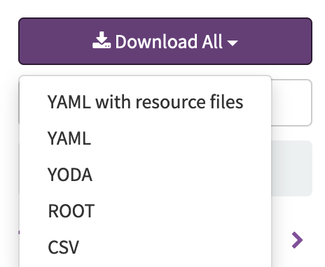
Rivet
Rivet: Most widespread way by which analysis code from the LHC and other high-energy collider experiments is preserved.
  Used for generator tuning
  Provides set of experimental analyses
  Rivet wishlist, installation
Analysis name: <Experiment>_<publication_year>_I<InspireID>
  E.g.: LHCB_2021_I1889335
Each Rivet-analysis consists of one …
  .cc file containing the analysis code
  .yoda file containing the data points (from HEPData)
  .info file containing metadata
  .plot file setting plotting options

Slide 13
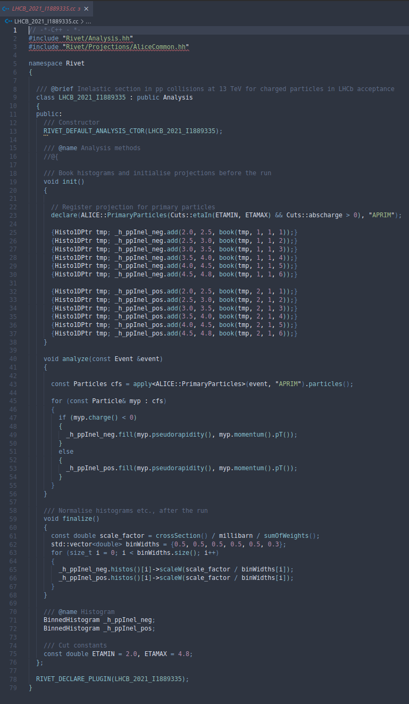
Rivet Analysis Code
An analysis is usually written in one .cc file containing
  A no-argument constructor
  Three analysis event loop methods:
    init: book histograms, initialise counters, etc.
    analyze: per event: select particles, apply cuts, construct observables, fill histograms etc.
    finalize: normalize/scale/divide histograms, tuples, etc.
  A minimal hook into the plugin system
Projections: observable calculator objects that are called by the analysis' apply(event) method.
  Refer to projection declared in init method
Compiled via rivet-build <NAME>.cc
  Generates a RivetAnalysis.so file

Slide 14
Rivet Analysis Code
An analysis is usually written in one .cc file containing
  A no-argument constructor
  Three analysis event loop methods:
    init: book histograms, initialise counters, etc.
    analyze: per event: select particles, apply cuts, construct observables, fill histograms etc.
    finalize: normalize/scale/divide histograms, tuples, etc.
  A minimal hook into the plugin system
Projections: observable calculator objects that are called by the analysis' apply(event) method.
  Refer to projection declared in init method
Compiled via rivet-build <NAME>.cc
  Generates a RivetAnalysis.so file

Slide 15
Rivet Analysis Code
An analysis is usually written in one .cc file containing
  A no-argument constructor
  Three analysis event loop methods:
    init: book histograms, initialise counters, etc.
    analyze: per event: select particles, apply cuts, construct observables, fill histograms etc.
    finalize: normalize/scale/divide histograms, tuples, etc.
  A minimal hook into the plugin system
Projections: observable calculator objects that are called by the analysis' apply(event) method.
  Refer to projection declared in init method
Compiled via rivet-build <NAME>.cc
  Generates a RivetAnalysis.so file

Slide 16
Rivet Analysis Code
An analysis is usually written in one .cc file containing
  A no-argument constructor
  Three analysis event loop methods:
    init: book histograms, initialise counters, etc.
    analyze: per event: select particles, apply cuts, construct observables, fill histograms etc.
    finalize: normalize/scale/divide histograms, tuples, etc.
  A minimal hook into the plugin system
Projections: observable calculator objects that are called by the analysis' apply(event) method.
  Refer to projection declared in init method
Compiled via rivet-build <NAME>.cc
  Generates a RivetAnalysis.so file

Slide 17
Rivet Analysis Code
An analysis is usually written in one .cc file containing
  A no-argument constructor
  Three analysis event loop methods:
    init: book histograms, initialise counters, etc.
    analyze: per event: select particles, apply cuts, construct observables, fill histograms etc.
    finalize: normalize/scale/divide histograms, tuples, etc.
  A minimal hook into the plugin system
Projections: observable calculator objects that are called by the analysis' apply(event) method.
  Refer to projection declared in init method
Compiled via rivet-build <NAME>.cc
  Generates a RivetAnalysis.so file

Slide 18

Running and submitting a Rivet-plugin
You can run your compiled code via
rivet -a <Name> <inputfile>
  inputfile: .hepmc file
  Style: .plot file
  Rivet provides example files to test on
  Alternative: Let your favourite generator generate some events for you!
  Produces Rivet.yoda file
Plotting: rivet-mkhtml --errs Rivet.yoda
Outputs look sane → Internal Review /MR in RIVET
${10}^{3}$ MB events - LHC-13-Minbias.hepmc.gz

Slide 19

Running and submitting a Rivet-plugin
You can run your compiled code via
rivet -a <Name> <inputfile>
  inputfile: .hepmc file
  Style: .plot file
  Rivet provides example files to test on
  Alternative: Let your favourite generator generate some events for you!
  Produces Rivet.yoda file
Plotting: rivet-mkhtml --errs Rivet.yoda
Outputs look sane → Internal Review /MR in RIVET
${10}^{6}$ MB events - Gauss v56r4
provided by A. Grecu

Slide 20
Additional Remarks

Slide 21
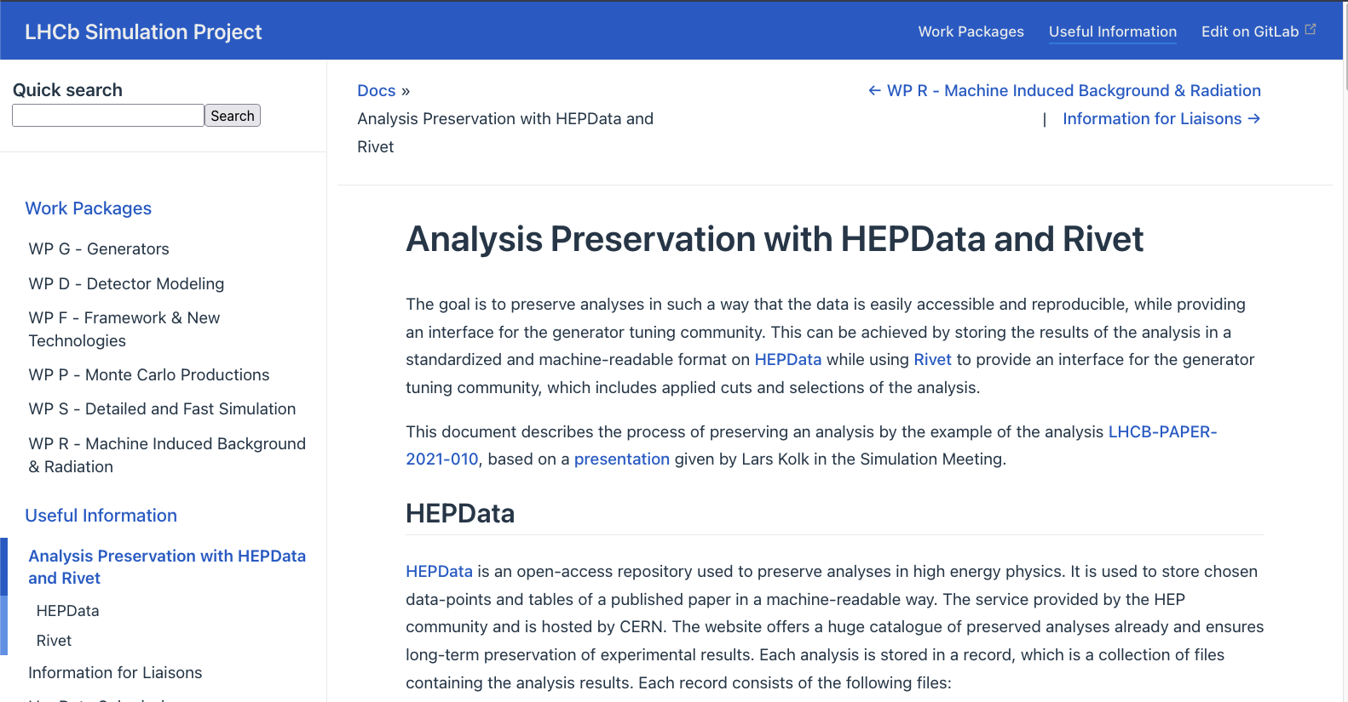
Analysis Preservation Guide
Written Analysis Preservation Guide, including all important steps

Slide 22
Connection to SFB1491
F3 & F4 Deliverables: “Selected LHCb analyses will have been adopted for the use with Rivet”
Provide plugins for generator tuning in (astro)-particle physics
Several rivet plugins written by Chloé, e.g.
  NA61SHINE_2019_I1754136
  HARP_2008_I778842
  HARPCDP_2010_I863735
  LHCB_2011_I891233
Pion/Kaon/Proton projectile against carbon target in forward rapidity regions

Slide 23
Summary
  Archiving published analyses for public access
    Promotes transparency and reproducibility
    Increases impact of analyses
  Analyses can be archived …
    Data: HEPData
    Code: Rivet
  Preservation procedure shown by example LHCB_2021_I1889335
  Written guide to help with analysis preservation
  Rivet plugins are important deliverables for the SFB
  Rivet plugins can be used by anybody’s generators based off your results!

