Slide 1
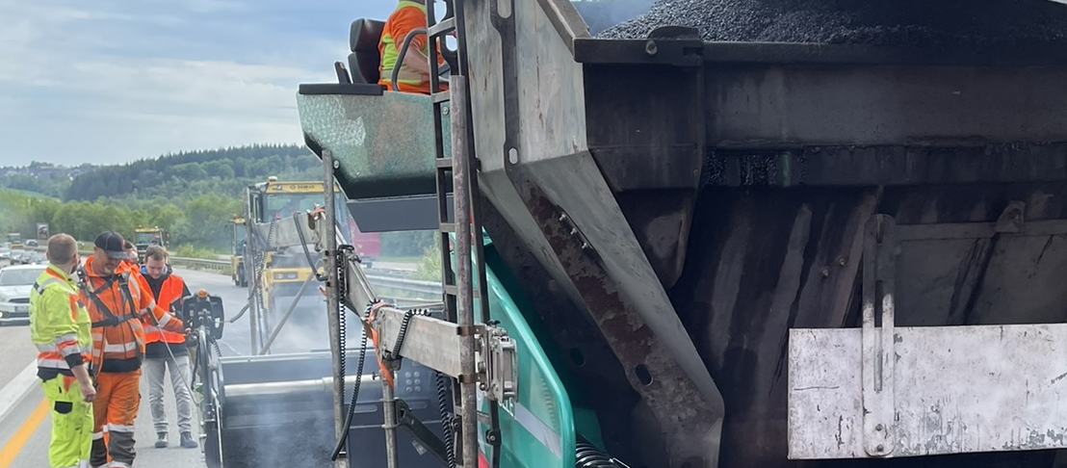
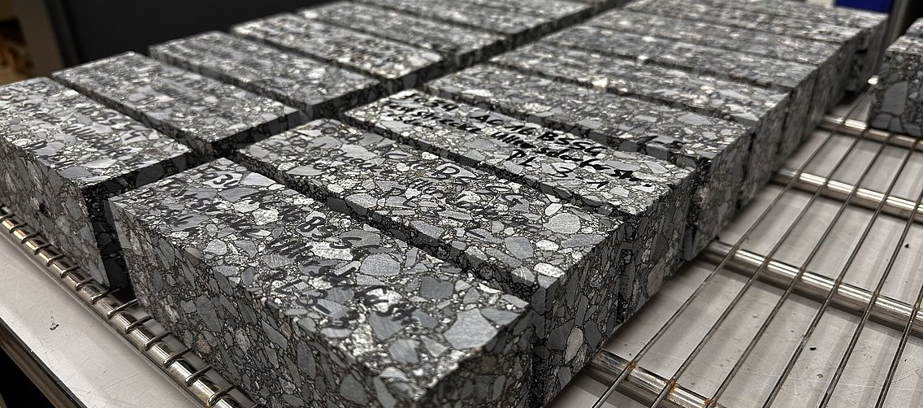

Sustainable Road Construction due to the use of Temperature-Reduced Asphalt
Foto: BESTLAB
1st TEC2ZERO Symposium
Introduction
Roller-compacted asphalt is processed and paved at temperatures between 140 °C and 195 °C for use in road construction
In order to minimize the health risks for employees during hot paving, an occupational exposure limit (OEL) for vapors and aerosols during the hot processing of bitumen at 1.5 mg/m³ was established in 2019
Reduction in emissions can be achieved by using temperature-reduced (TR) asphalt
Mixing and paving temperatures are lowered by at least 20 K compared to conventional asphalt
In addition to the reduction in emissions, energy consumption during the asphalt production and consequently CO₂ emissions can also be significantly reduced
Organic, mineral and chemical additives are used to ensure workability at reduced paving temperatures.
Objective
In order for TR asphalts to become the norm for sustainable road construction, it is necessary to determine their performance properties and verify their comparability with conventional asphalts
Conclusion
Results demonstrate a high degree of comparability between temperature-reduced asphalts and reference asphalts
Properties could be identified in which TR asphalts perform better than ref. asphalts
The results obtained in the laboratory were also confirmed in the in-situ test fields.
Laboratory test programme
As part of a research project, extensive tests were carried out in the laboratory BESTLAB
Tests at asphalt and binder level on temperature-reduced asphalts and on non-temperature-reduced asphalts as a reference
Determination of rutting resistance
Assessment of low-temperature behaviour
Evaluation of stiffness and fatigue behaviour
Behaviour of recovered and long-term aged bitumen
Tim Schrödter* | Pahirangan Sivapatham | Panujan Naguleswaran
University of Wuppertal
Department of Road Construction and Road Maintenance
* Corresponding author. E-mail address: t.schroedter@uni-wuppertal.de
School of Architecture and Civil Engineering
This report is based on parts of the research project carried out at the request of the Federal Ministry of Transport, represented by the Federal Highway and Transport Research Institute, under research project No. FE 07.0312/2021/ERB. The author is solely responsible for the content.

